Slide 1
Sabino Counseling Advisory Council
Fall 2023 Inaugural Meeting

Slide 2
School Data: MTSS Applications

Slide 3
What We Do
I text (texting is more productive than letters or emails or even phone calls) parents to meet with teachers, student and Counselors (Academic and Mental Health) and Admin as needed.
Collaborate with Drop Out Prevention
Collaborate with African American Student Supports
Use CICO and PBIS Rewards to motivate students
As needed: Cover ISI, substitute and as requested
Staff the PBIS store—PBIS improves school climate which reduces absences

Slide 4
MTSS-Multi-Tiered System of Supports
Sabino historically is an "A" school. It is an open enrollment school with 75% of students traveling to us, we also have many (70%) students with less than proficient skills—skills that must be raised.
The need for Counseling-MTSS services is essential and urgent
MTSS Tiers are based on having 0, 1, or more F Grades (2 or more Fs in a grading period) and or 30% or more absences.
This last grading period we had approximately 75 students meeting Tier 3 Grades criteria and 10 students meeting absences criteria.
Note: 9th Graders comprise about 35% of the students in Tier 3—those with 2 or more Fs. Seniors and Juniors tend to have more absences.

Slide 5
How We Do It
2 parent meetings each day on Tue and Thurs and others as needed through the week
Devise a plan for teachers to implement
Teach students to ask for help at Conference and to use better Time Management
Encourage teachers to report issues earlier
Organize Targeted Learning program for ACT and Benchmark
Collaborate with CSP to coach teachers–for example:
Students should take Benchmark testing seriously. If students at the cusp of Proficient get even 2 more questions correct, we see improvement in school ranking or “Grade”.
Benchmark data for incoming students can help with curriculum planning and placement. incoming students can help with curriculum planning and placement.
Increase the use of IXL and develop other programs such as promoting Paper (a live online tutoring program).

Slide 6
Outcomes (typical month MTSS activity)
MTSS Observations | 450
Common Observation Types | Counseling, Absences, Academic
Requests for Support | 3
Count of new Minor Incidents | 18
New MTSS Academic Support Plans | 62
MTSS meetings conducted | 9
Plans for Success | 2
Lunch Detention/Behavior support | 2
PBIS Store | 3
Parent Meetings | 4
New Student meetings | 5
IEP Meetings | 2
Credit recovery | 20
The percent of students with multiple Fs is starting to decline over the last year
The Code of Behavior is starting to result in students seeing that substance use such as vaping or disrespect to teachers and peers is not going to be accepted and “no fun”.
The number of MTSS meetings per month has increased about 50% over the prior year

Slide 7
Annual Calendar

Slide 8
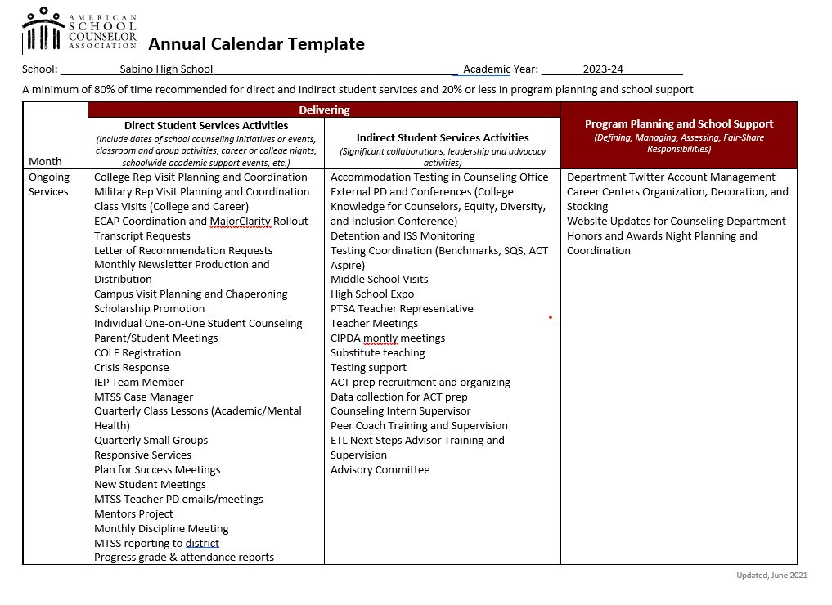

Slide 9
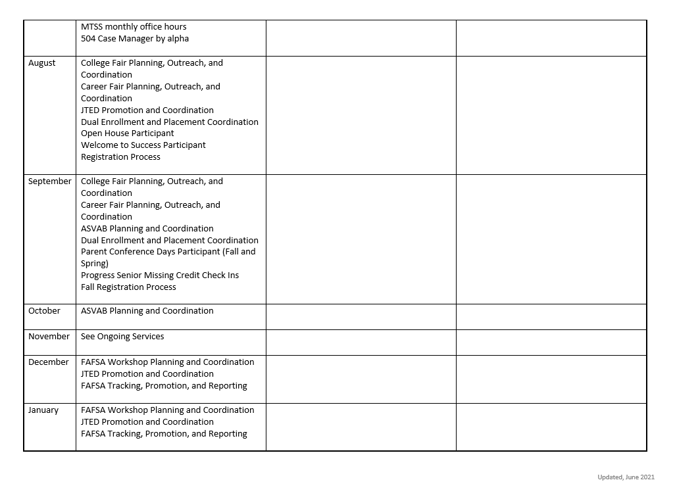

Slide 10
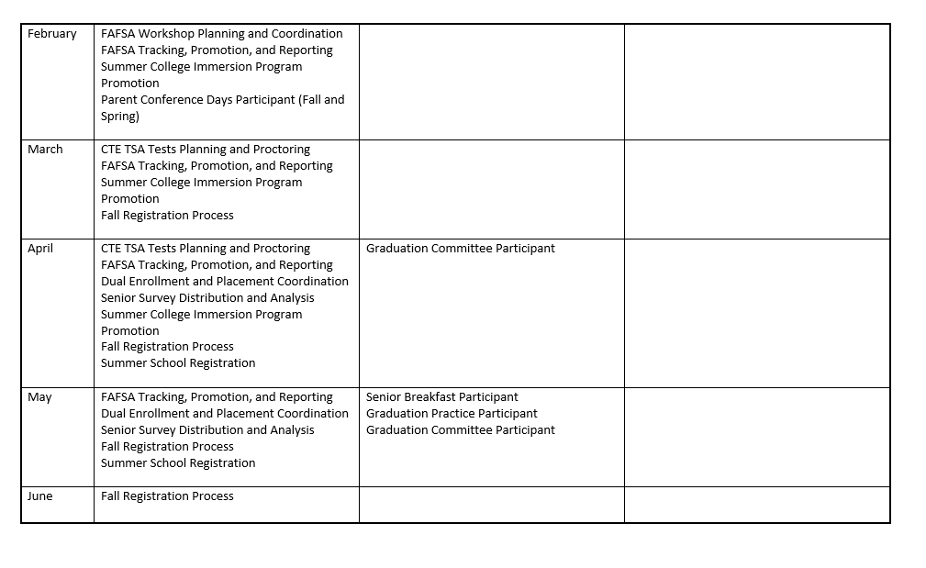

Slide 11
Student Mental Health
And the School Counselor

Slide 12
What does a School Mental Health Counselor do?
Recognize and respond to mental health services needs
Short term counseling interventions
Referral to community mental health services for long term support
Advocate for all students' mental health needs through education that enhances mental health awareness
Promote Social/Emotional Wellness & Awareness

Slide 13
Recognize and Respond
RECOGNIZE:
Changes in school performance
Attendance issues
RESPOND:
One-on-one CICOs
Short term counseling
Crisis intervention

Slide 14
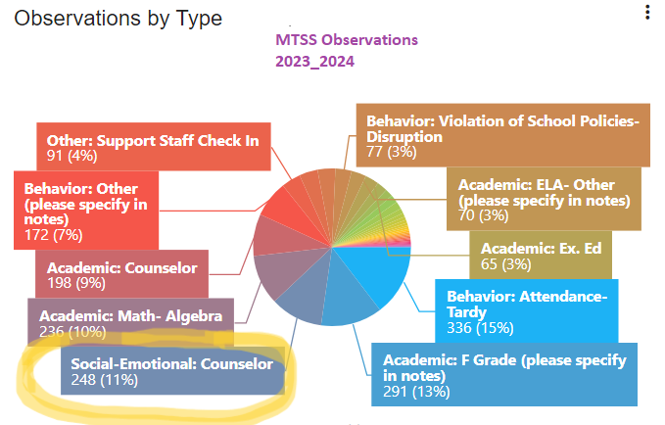
MTSS Observations

Slide 15
Interventions
Classroom Lessons
Restorative Practices
Effective Communication
Developing Healthy Coping Skills
Substance Use: An Unhealthy Coping Strategy & Effects on Brain
Emotions & the Brain
Small Group
Communication & Conflict Resolution
Healthy Habits & Managing Stress
Mood Management & Emotional Regulation
Self-care & Mindfulness
Anxiety: Causes & Coping Strategies
Crisis Intervention
Crisis Intervention (panic attacks, suicidal ideation)
Return to School Safety Plan(s)

Slide 16
Referrals
Address barriers (stigma, cultural, linguistic) through parent communication and updating website & social media
Referral to community partners (La Frontera, TalkItOut UA) for long term issues
Over 30 given to date (over a dozen just this year)

Slide 17
Advocating
Recognition of MH Awareness days throughout the year
Advocate, Collaborate, & Coordinate with community partners:
Teen Maze (AZYP, COPE, La Frontera, Pima County Courts, TMC)
African American Youth Heritage Day
Distracted Driving Prevention (AZYP, TPD, MADD, Desert Mortuary, EMT Services)

Slide 18
Promote
Proactive Instruction throughout School Year
Proactive Instruction Enhances Awareness
Increased Awareness Prevents Crisis
Crisis Prevention Promotes a Healthy & Safe Campus
A Healthy & Safe Campus Fosters Student Achievement

Slide 19
Academic Domain
Student Academic Support

Slide 20
Student Support Meetings
Plan For Success
MTSS Process
A Student-Teacher-Parent meeting that is facilitated by the School Counselor to help develop a Plan for Success in a specific class the student is struggling in.
May require a follow-up meeting with an Administrator in attendance.
(Multitiered System Of Support)
An academic team meeting with the MTSS Coordinator, student, parents, all the student's teachers, counselor team, and administrator to develop an MTSS Plan for support.

Slide 21
504-Plan Meetings
Section 504 of the Rehabilitation Act of 1973, commonly called “Section 504,” is a federal law that assures that students with disabilities have educational opportunities and benefits equal to those provided to students without disabilities. To be eligible, a student must have a physical or mental impairment that substantially limits one or more major life activity.
Counselors will facilitate, monitor, and support this process for students who are eligible for a 504-plan.

Slide 22
CREDIT RECOVERY
BEFORE/AFTER SCHOOL
0-Period: Meets daily at 7am
7th Period: Meets from 3:20pm-4:35pm daily (except Wednesdays)
SCHEDULED CLASS
If a student is missing multiple credits, a credit recovery class will be placed on the student schedule. This class will replace an elective class, but without the credit.

Slide 23
CREDIT RECOVERY MONITORING
STUDENT SUPPORT COACH
Counselors act as student support coaches for students who are registered in the APEX computer program.
Counselors monitor student progress and provide guidance on the completion of missing credits for students and to credit recovery teachers.
SENIOR MISSING CREDIT
Counselors will monitor a Senior Missing Credit Roster for seniors who are in need of credit recovery for graduation.
Every 4 ½ weeks (once a month), counselors will email a missing credit notice to students & parents. A missing credit form (Red Form) will be mailed home.
Counselors will meet with seniors in individual meetings to discuss and support progress of credit recovery.

Slide 24
Summer Session
Counselors support and monitor student success in the summer session.
Counselors will monitor credit recovery progress.
Counselors will support students in Freshman Academy, as they are introduced to the Sabino campus and high school life.
Counselors will support fall registration of incoming students.
Counselors will review senior transcripts in order to develop the Senior Missing Credit Roster.
Counselors will review 504-plans for the new school year.

Slide 25
Registration Process
Classroom Lessons
Completion of course request documents
Entering course requests in Synergy
Creation of the Master Schedule
Correction of schedule errors
Leveling of classes
New Student Registration
Review of Student Transcript
Student Schedule Creation
Parent & Student Welcome Meetings
Middle School Visits
High School Fairs

Slide 26
Post-High School Planning
Student Academic Support

Slide 27
Our Services
College
College Fairs (Fall)
College Search
Admissions Process
FAFSA and Financial Aid
College Readiness Workshops
Letters of Rec
College Essay Help
Career
Career Fair (Spring)
Resume Workshops
Practice Interviews
MajorClarity Assistance
Career and Technical Education
JTED Programs

Slide 28
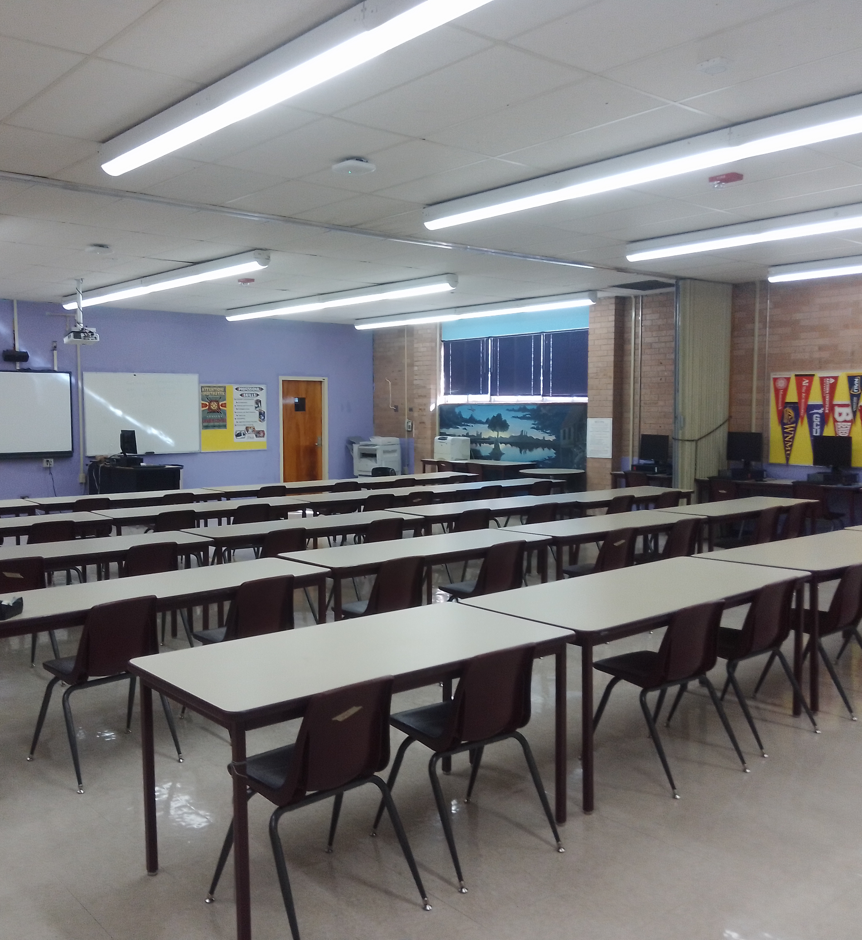
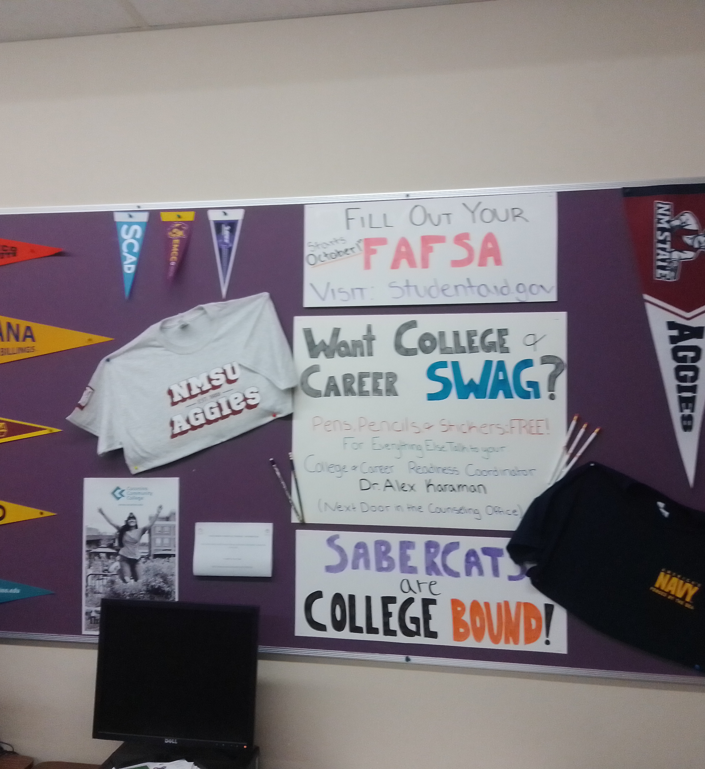
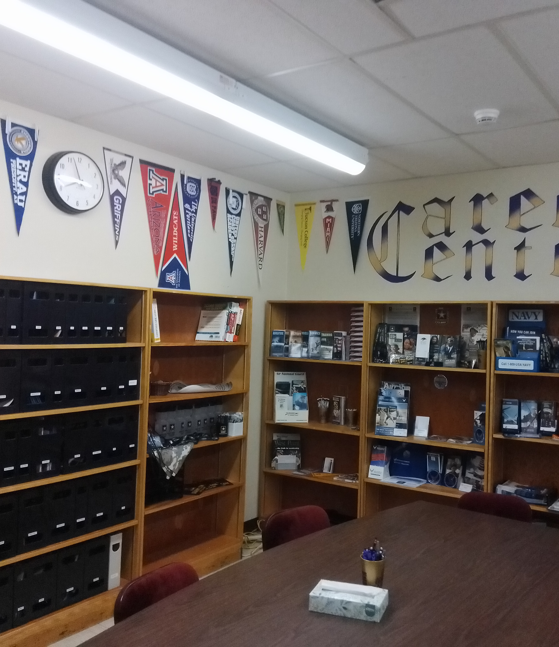
College and Career Centers
Administration Building
College Swag
Admissions and Recruitment Materials
Armed Forces Info
Community College and Transfer Info
CTE and JTED Pamphlets
Room 125
Career Resources
Scholarship and FAFSA Info
Armed Forces Info
CTE and JTED Pamphlets
Laptops for Workshops

Slide 29
College and Career Interns
AmeriCorps Interns – A Major National Non-Profit
Peer College Coach: Hayleigh Edmonds, Sabino Senior
Next Steps Advisor: Alyssa Ortega, UofA Sophomore
Sign up links are emailed and teachers have sign up QR codes

Slide 30
Thank You for Attending!!

