Slide 1

Sabino Counseling DEPARTMENT
Advisory Council
Fall 2024

Slide 2

COUNSELING DEPARTMENT TEAM
Renee Ibarra: Department Chair-Counselor for Alpha Students O-Z
Kristine Mateos: Counselor for Alpha Students A-G
Photini Deshaies: Counselor for Alpha Students H-N
Dr. Alexander Karaman: College & Career Counselor
Steve Marks: MTSS Facilitator

Slide 3


Sabino Counseling Department: Following the A.S.C.A Model

Slide 4

NEW YEAR, NEW GOALS
District renewed funding for an additional counselor
Site created adjustment to assigned students
Application process for R.A.M.P.

Slide 5

A.S.C.A. & R.A.M.P. we submitted our application!
(thanks to PTSA for support)

Slide 6

SABINO COUNSELING STUDENT SURVEY
SCHOOL YEAR 2024-2025

Slide 7
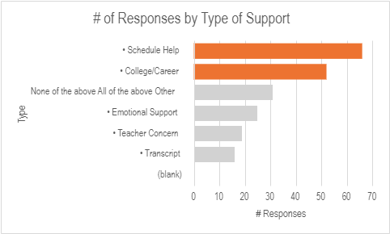
Schedule Help & College/Career Support Are The Top Student Supports Used

Slide 8
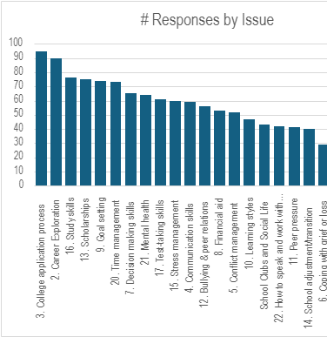
College & Career Topics Are Top Student issues

Slide 9

ACADEMIC SUPPORT

Slide 10



ACADEMIC SUPPORT
TIER 1: INTERVENTIONS
TIER 2: Plan for Success
TIER 3: 504 Meeting
REGISTRATION PROCESS
GRADE CHECKS
CREDIT CHECKS
CREDIT RECOVERY SUPPORT
SUMMER SCHOOL SUPPORT
  A Student-Teacher-Parent meeting that is facilitated by the School Counselor to help develop a Plan for Success in a specific class the student is struggling in.
To be eligible, a student must have a physical or mental impairment that substantially limits one or more major life activity.
Counselors will facilitate, monitor, and support this process for students who are eligible for a 504-plan.

Slide 11

2024-2025 ACADEMIC GOAL:
Increase overall STUDENT SUPPORTS BY REDUCING THE STUDENT TO COUNSELOR RATIO

Slide 12

SOCIAL-EMOTIONAL SUPPORT

Slide 13

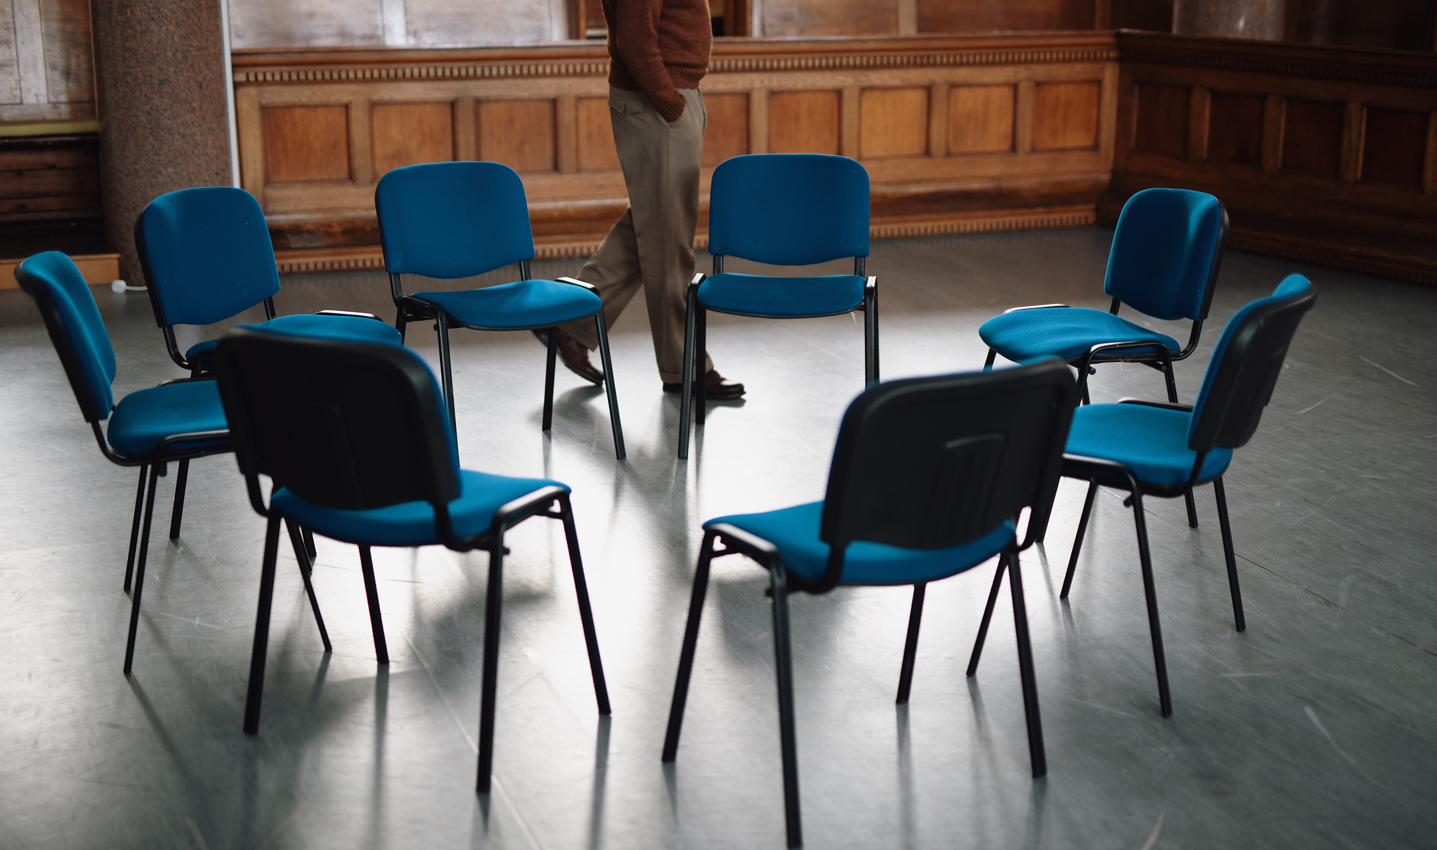

S.E.L. INTERVENTIONS
TIER 1: Schoolwide
TIER 3: Crisis Intervention
TIER 2: Targeted Support
Assessment and community referrals
Return to School Safety Plans
Acting member of the Sabino Comprehensive School Threat Assessment Team
Member of the District Crisis Team, as needed
CLASSROOM LESSONS: Academic & S.E.L. Topics
SMALL GROUP: Focus on Mental Health Topics
INDIVIDUAL CHECK-INS

Slide 14

SEL DOMAIN GOALS 2024-2025
COUSELOR VISITS TO ALL GRADE LEVEL CLASSES 1X PER QUARTER TO DELIVER COUNSELOR LESSONS WITH AN ACADEMIC & SEL FOCUS
FACILITATE SMALL GROUP 1X A SEMESTER (8 WEEKS) WITH A FOCUS ON MANAGING MENTAL HEALTH AS A TIER 2 INTERVENTION
FACILITATE SABINO'S STUDENT SUPORT TEAM (S.S.T.) 2X A QUARTER

Slide 15

COLLEGE & CAREER

Slide 16

CCRC Updates
Added a second Earn To Learn Next Steps Advisor to bring total of interns to three and weekly internship hours to 45
Opened new College and Career Lounge in Building 3 to house ETL Next Steps Advisors
After bonus point, received over 100% of CCRI points towards school letter grade

Slide 17
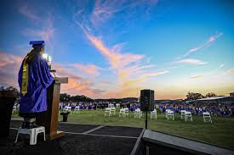
COLLEGE & CAREER GOALS
2024-2025
ASCA Outcome Goal for 2024-25: "Increase the number of students who have completed the FAFSA prior to graduation by ten percent."

Slide 18

M.T.S.S. applications: SUPPORTING THE ACADEMIC domain

Slide 19
M.T.S.S. PROCESS: HOW IT WORKS.
WHY MTSS ?---
1/2 of students has at least one F; 1/8 has excess absences.
3 MTSS "TIERS"
Tier 1: Grades of A-B-C == teaching and learning for all
Tier 2 : Grade of D or F == added supports in class and Conference
Tier 3 : 2 or more F grades, excessive absent/Tardy == Out of class support: CICO, PBIS/Grade Check, 1-on-1 Counseling, RTI, Tutoring, Credit Recovery.
MTSS Plans ==created with student, teachers, family, and Alpha Counselor. Plans require progress monitoring. MTSS Plan progress== foundation of 504 and IEP process.
Plans may be for individual or mass interventions.
We have 2 current mass interventions…

Slide 20

PENCILS & PANCAKES supports Tiers 1-2-3
Wednesdays: 7-7:45am
Homework help & Tutoring
Grade Check and PBIS Recognition/CICO
Pancakes
Coffee
Open to all– Universal interventions > Targeted interventions

Slide 21
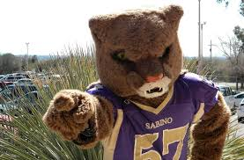
SABER ACADEMY
Tiers 2 and 3 but open to all
Tuesdays & Thursdays
8-8:55am
Open to all
Get homework help, learn study skills, learn to self-advocate and ask for help, assist Freshman with transition from middle school to high school
Math RTI/Tutoring on Tuesdays during Saber Academy

Slide 22

Closure, Feedback, Questions, Concerns

Slide 23

NEXT MEETING: APRIL 29TH AT 8AM

Slide 24
THANK YOU FOR ATTENDING!

