Slide 1

COUNSELING LESSON
QUARTER 2-2024

Slide 2
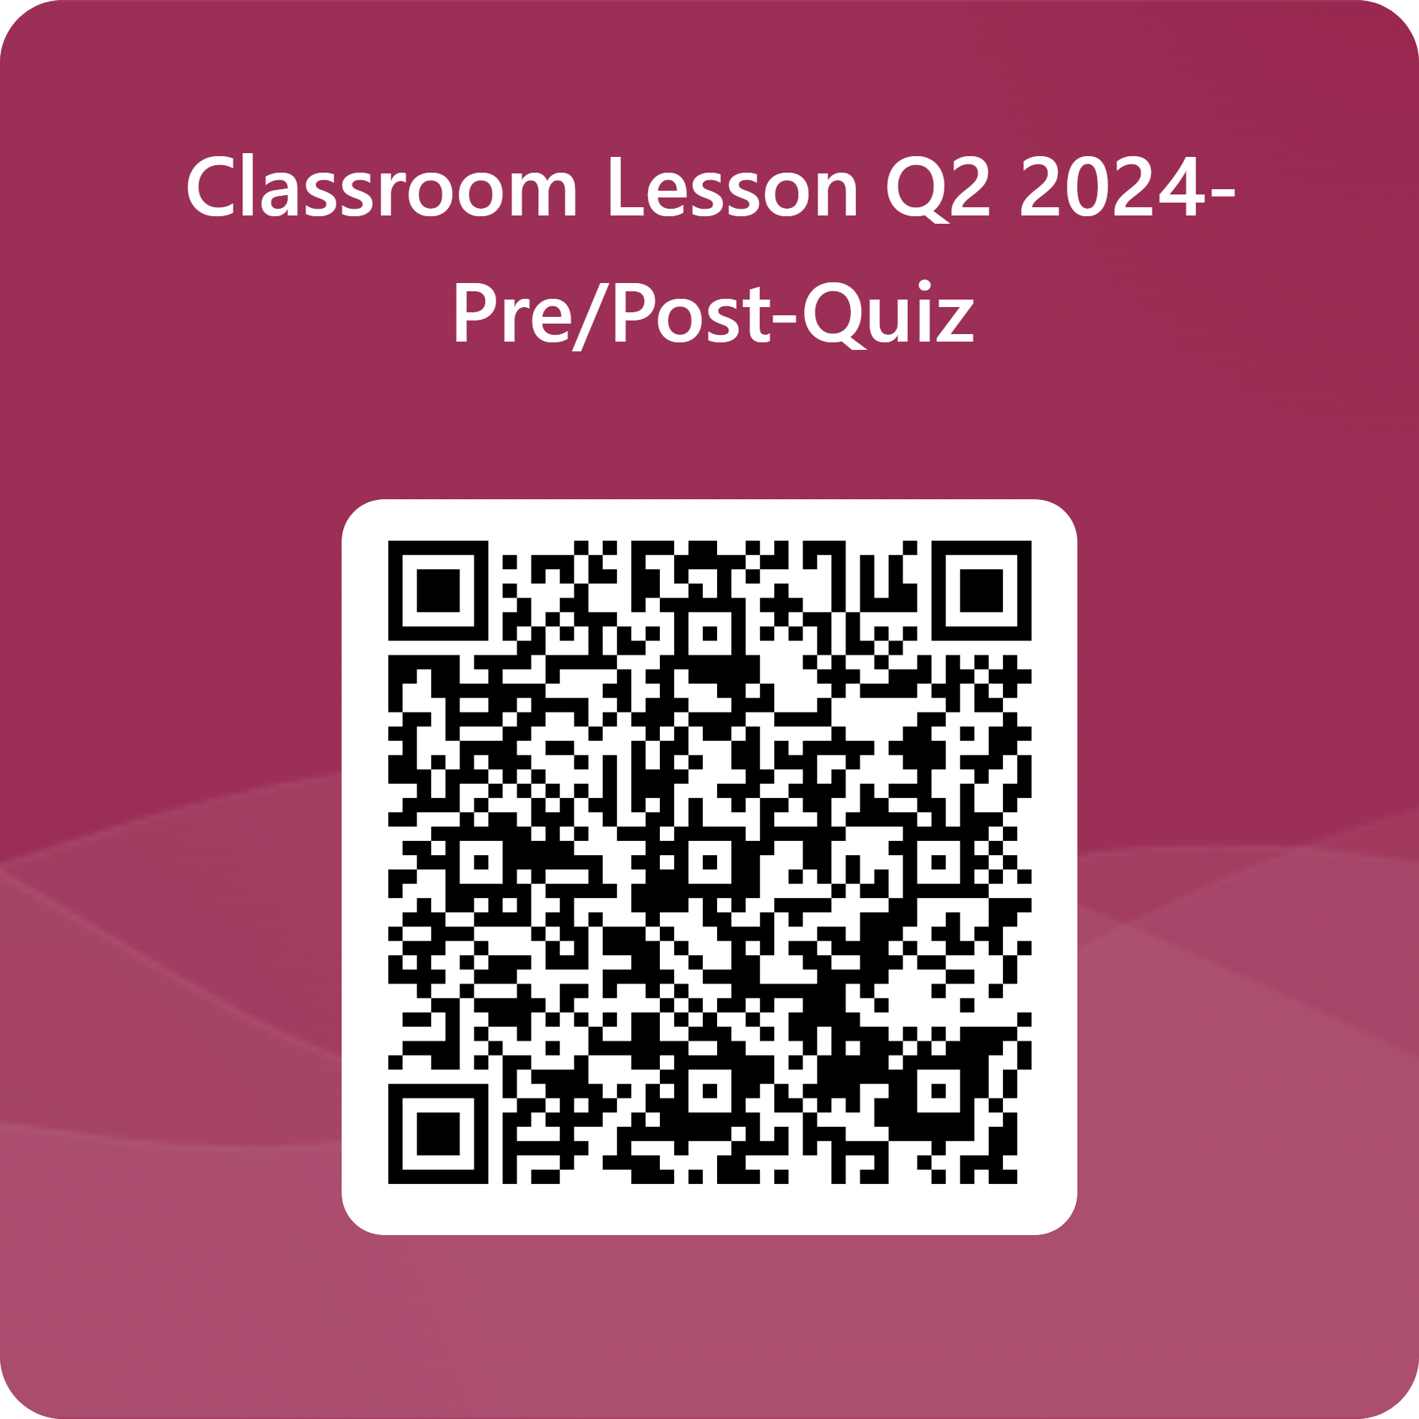
Pre-Quiz

Slide 3
COUNSELING TEAM
Renee Ibarra-Department Chair-Students 0-Z
Kristine Mateos-Students A-G
Photini Deshaies-Students H-N
Dr. Alexader Karaman-College & Career
Steve Marks- MTSS Coordinator

Slide 4
GRADING PERIODS
SEMESTER 1
SEMESTER 2
QUARTER 1 - Ends October 4th
QUARTER 2 - Ends December 20th
Winter Final Exams
December 18th & 19th
Semester 1 Grades = "D" and above to earn Semester 1 Credit
QUARTER 3 - Ends March 7th
QUARTER 4 - Ends May 23rd
Spring Final Exams
May
Semester 2 Grades = "D" and above to earn Semester 2 Credit

Slide 5


GRADUATION CREDITS (23)
English-4 credits
Math- 4 credits (Algebra I, Algebra II, Geometry, Math 4)
Science-3 credits
World History-1 credit
American History-1 credit
American Government-0.5 credit
Economics-0.5 credit
PE-1 credit
Health 0.5 credit
Fine Art or CTE-1 credit
Electives-6.5 credits*
*World Language-2 consecutive years for College/University Admissions

Slide 6
CREDIT RECOVERY
BEFORE OR AFTER SCHOOL DURING 0-HOUR OR 7TH PEIROD
DURING THE DAY-ON YOUR SCHEDULE
SUMMER SCHOOL
*DO NOT WAIT TO RECOVER CREDITS!
Limited Courses

Slide 7

ACADEMIC SUPPORT
CONFERENCE PERIOD-TUESDAY/THURSDAY MORINGS
PLAN FOR SUCCESS MEETINGS
  Step 1: Parent & student meet with the teacher.
  Step 2: Parent, student, teacher, & the counselors meet to discuss a plan.
  Step 3: Parent, student, teacher, & counselors meet with administrator to discuss possible options of support.
MTSS PROCESS-With Mr. Marks

Slide 8

What's your style?

Slide 9



3 LEARNING STYLES
AUDITORY
VISUAL
TACTILE
You learn by hearing and listening. You understand and remember things you have heard. You store information by how it sounds and have an easier time understanding spoken instructions than written ones. You often learn by reading out loud because you must hear or speak it to know it.
You learn by reading or seeing pictures. You understand and remember things by sight. You can picture what you are learning in your head, and you learn best by primarily visual methods. You like to see what you are learning.
You are a "hands-on" learner who prefers to touch, move, build, or draw what you learn, and you tend to learn better when some type of physical activity is involved.

Slide 10

AUDITORY
Sit where you can hear.
Have your hearing checked on a regular basis.
Use flashcards to learn new words; read them out loud.
Read stories, assignments, or directions out loud.
Record yourself spelling words and then listen to the recording.
Have test questions read to you out loud.
Study new material by reading it out loud.
*Remember that you need to hear things, not just see things, to learn well.

Slide 11

VISUAL
Sit near the front of the classroom. (It won't mean you're the teacher's pet!)
Have your eyesight checked on a regular basis.
Use flashcards to learn new words.
Try to visualize things that you hear or things that are read to you.
Write down key words, ideas, or instructions.
Draw pictures to help explain new concepts and then explain the pictures.
Color code things.
Avoid distractions during study times.
*Remember that you need to see things, not just hear things, to learn well.

Slide 12

TACTILE
Participate in activities that involve touching, building, moving, or drawing.
Do lots of hands-on activities like completing art projects, taking walks, or acting out stories.
It's okay to chew gum, walk around, or rock in a chair while reading or studying.
Use flashcards and arrange them in groups to show relationships between ideas.
Take frequent breaks during reading or studying periods (frequent, but not long).
It's okay to tap a pencil, shake your foot, or hold on to something while learning.
Use a computer to reinforce learning through the sense of touch.
*Remember that you learn best by doing, not just by reading, seeing, or hearing.

Slide 13

STUDY HABITS

Slide 14
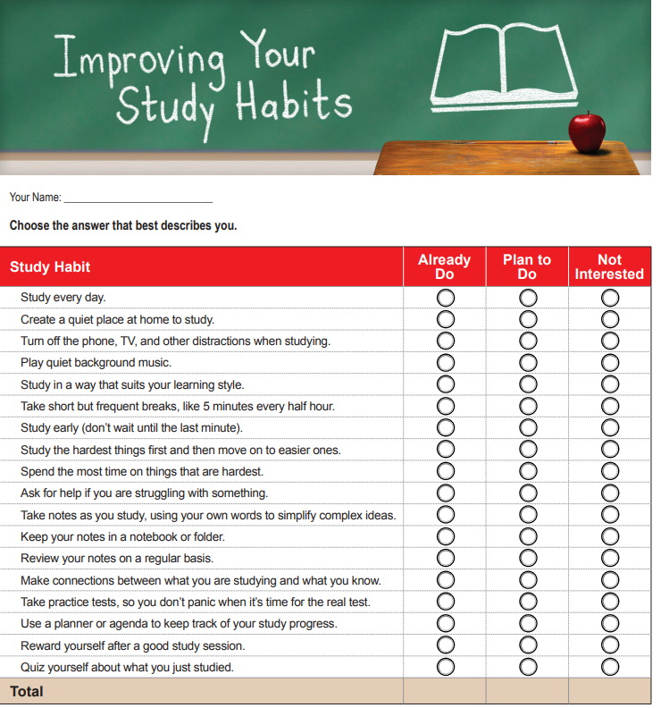

Slide 15

WINTER FINAL EXAMS
DECEMBER 18TH & 19TH-Start reviewing NOW!

Slide 16
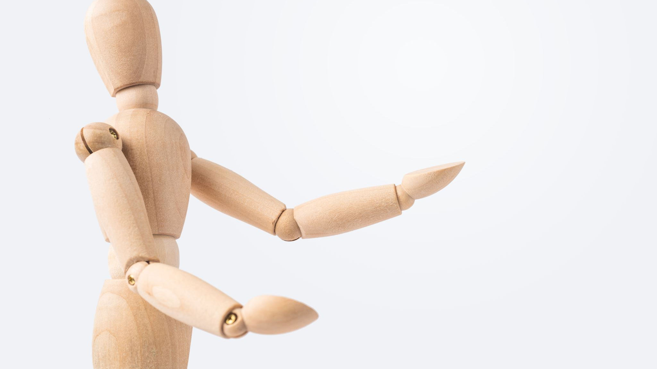
Radical Acceptance
How to manage feelings of distress.

Slide 17
MINDSET REVIEW
FIXED
GROWTH
BELIEVING YOUR ABILITIES ARE FIXED AND PERMANENT
FAILURE IS THE LIMIT OF ABILITIES
BEING CHANLLENGED IS NOT TOLERATED
STAYING STUCK AND FRUSTRATED INSTEAD OF BEING ADAPTABLE TO CHANGE
FEEDBACK IS PERSONAL
BELIEVING YOUR ABILITIES CAN GROW, ADAPT, AND CHANGE OVER TIME
FAILURE IS AN OPPORTUNITY TO GROW
FEEDBACK IS CONSTRUCTIVE
BE ADAPTABLE TO CHANGE
TRY NEW THINGS

Slide 18
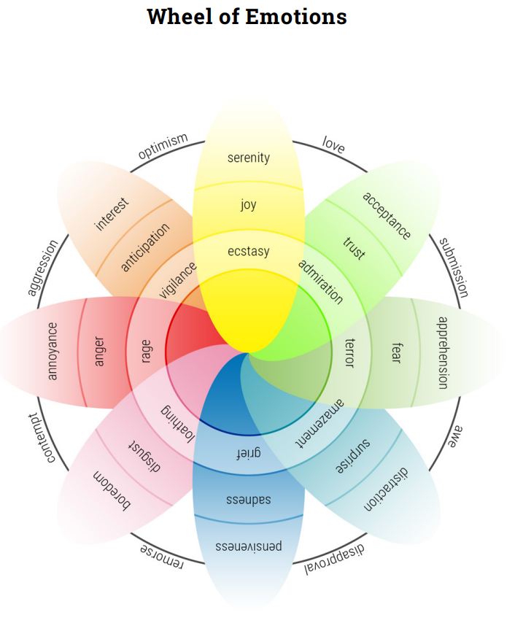

Slide 19

Distress = Yucky feelings that we can carry around ("emotional baggage").
*Guilt
*Shame
*Worry
*Fear
*Doubt
*Anger
*Grief
*Sadness
*Disappointment

Slide 20

Managing distress using radical acceptance.

Slide 21
Choices to Accept Reality
SOLVE THE PROBLEM
  Can the problem be solved?
  What are possible solutions to the problem?
CHANGE WHAT YOU THINK OR HOW YOU FEEL ABOUT THE PROBLEM
  What can I say to myself to feel better in this situation?
  Are there emotional regulation/coping skills I can use?
ACCEPT THE PROBLEM
  Can I tolerate or accept the problem?
  What reality acceptance statements can I say to myself?
STAY STUCK & MISERABLE
  Do I want to stay stuck and miserable?
  What are the short-term and long-term consequences of staying stuck?

Slide 22

STEPS TO RADICAL ACCEPTANCE
OBSERVE YOUR THOUGHTS, FEELINGS, BODY CUES, AND WORDS.
  What are my feelings and thoughts about the situation?
  How am I physically feeling? (headache, stomachache)
  What words/vocabulary am I using to describe the situation? ("always", "never", "should")
USE SELF-TALK
  Remind yourself that this unpleasant reality or distressful feeling will pass.
  "It is what it is"
  "This too shall pass."
CONSIDER CAUSES OF THE REALITY
  Sometimes knowing the causes or reasons behind the reality of a situation makes it easier to accept what is really going on.
  Consider the other person's point-of-view. Sometimes it's not always about you. Try perspective taking.

Slide 23

Things that harm radical acceptance and maintain distressful feelings.
Rumination: a cycle of negative thinking that interferes with positive coping. Your thoughts don't have an "off button".
Defensiveness: Deflecting responsibility of your own mistakes and behaviors and refusing to accept feedback.
Criticism: Dealing with problems through blaming others with hurtful expressions and judgement.
Stonewalling: Emotionally withdrawing, shutting down, or going silent during important discussions.

Slide 24

CONTROL & RADICAL ACCEPTANCE

Slide 25

THINGS TO REMEMBER...
WHAT ARE THINGS IN YOUR CONTROL AND WHAT IS OUTSIDE OF YOUR CONTROL?
HOW CAN YOU ACCEPT THE THINGS THAT ARE OUTSIDE OF YOUR CONTROL?
HOW CAN YOU EMBRACE THE THINGS THAT ARE INSIDE YOUR CONTROL?
HOW CAN YOU BE A PROBLEM-SOLVER AND NOT A PROBLEM-PROCRASTINATOR / PROBLEM ENABLER?

Slide 26
Student Example: Difficulty in school.
Resistance To Reality
Radical Acceptance Of Reality
Frustrated with his grades, Tim complains to his friends about his teacher. Instead of adapting to his teacher’s unconventional grading style, he insists on doing things his own way. Tim continues to get poor grades and ends up failing the class.
Tim is frustrated about his teacher, who seems to be grading papers unfairly. However, Tim knows he must pass the class, so he accepts that he’ll have to adapt. He schedules a meeting with his teacher, to understand the grading style (teacher perspective). This allows him to improve his class performance.

Slide 27


MINDSET & RADICAL ACCEPTANCE
FIXED MINDSET= RESISTANCE TO REALITY & MAINTAINING OF DISTRESS
GROWTH MINDSET= RADICAL ACCEPTANCE

Slide 28

RADICAL ACCEPTANCE AS
EMPOWERMENT:
The degree of autonomy and self-determination one has over their own life.
Having the knowledge, confidence, means, or ability to do things or make decisions for oneself.
The power to change things one can and accept the things one cannot change, while also knowing the difference between the two.

Slide 29
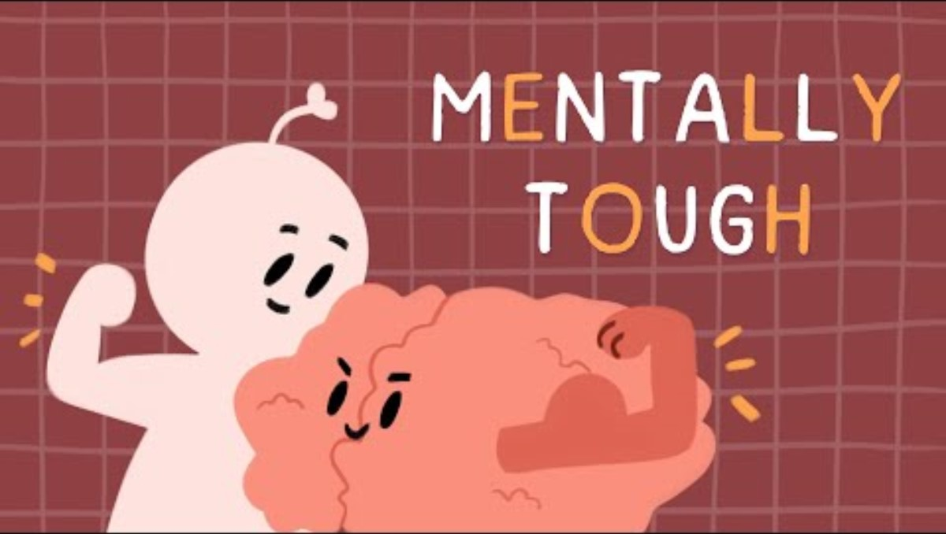
7 Secrets To Becoming Mentally Tougher

Slide 30

NOW... GO BE POWERFUL!

Slide 31

QUESTIONS?

Slide 32

Exit Quiz

