Slide 1

COUNSELOR LESSON
QUARTER 1- 2025

Slide 2

COUNSELING TEAM
RENEE IBARRA-Dept. Chair-Counselor (0-Z)
KRISTINE MATEOS-Counselor (A-G)
PHOTINI DESHAIES-Counselor (H-N)
DR. ALEXANDER KARAMAN-College & Career Counselor
STEVE MARKS-MTSS Facilitator

Slide 3
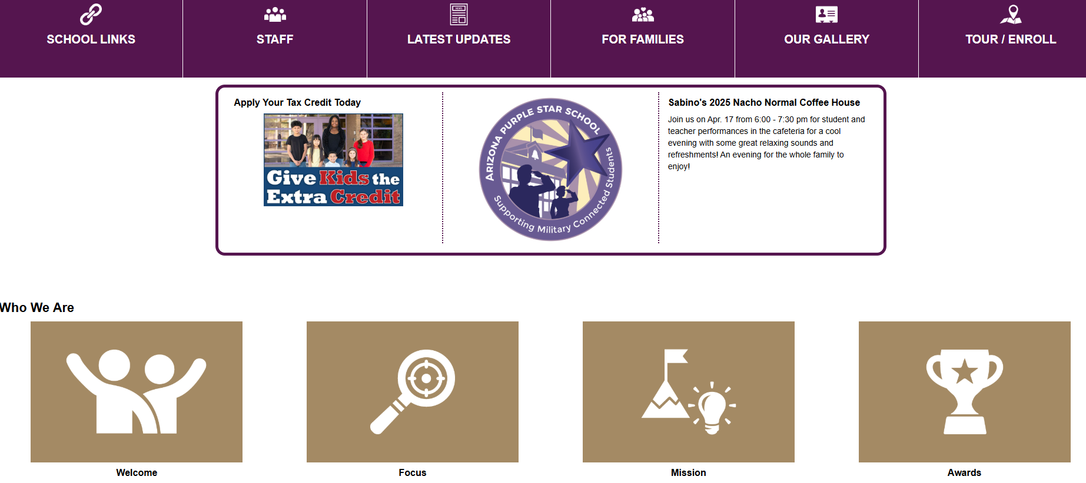

Slide 4

COUNSELING DEPARTMENT
ACADEMIC SUPPORT
SOCIAL-EMOTIONAL SUPPORT
Multi -Tiered Systems of Support (MTSS)
504 Plans
Course Requests
Plan for Success Meetings
Credit Recovery Plans
Assisting students with Four Year Graduation Plan
Credit Checks
Small group and individual check-ins
Classroom Lessons for Academic and Mental Health Topics

Slide 5

DR. K
COLLEGE AND CAREER SUPPORT
College Search
Career Exploration
Letters of Recommendation
FAFSA Help
Scholarship Help
JTED Program Counseling
Practice Interviews
Resume Building Workshops
College Fair
Admissions Process

Slide 6

2025-2026
TESTING SCHEDULE
ASVAB (12th grade)- September 23rd
PSAT-(Grade 11, optional)October 21st
ACT (11th grade)-April 9th
AZSCI (11th grade)-March 31st
ACT Aspire (9th Grade)-April 7th
AP Testing (Various Subjects)-May 4th-15th 2026

Slide 7

GRADING PERIODS
SEMESTER 1
SEMESTER 2
QUARTER 1- Ends Oct. 3rd
QUARTER 2- Ends Dec. 19th
WINTER FINAL EXAMS-DECEMEBR
SEMESTER 1 CREDIT = "D" AND ABOVE SEMESTER GRADE
QUARTER 3- Ends March 13th
QUARTER 4- Ends May 22nd
SPRING FINAL EXAMS-MAY
SEMESTER 2 CREDIT = "D" AND ABOVE SEMESTER GRADE

Slide 8

CREDIT CHECK
4 years of English
4 years of Math
3 years of Science
1 year of World History
1 year of American History
.5 year of American Government
.5 year of Economics
1 year of Fine Arts or Career & Technical Education
.5 year of Health
1 year of Physical Education
6.5 years of Electives*
*World Language-2 consecutive years are required for colleges and university

Slide 9

CREDIT RECOVERY
BEFORE OR AFTER SCHOOL
(0-HOUR / 7TH PERIOD)
SCHEDULED ON YOUR CURRENT SCHEDULE, DURING THE DAY
SUMMER SCHOOL
  Limited Courses/Credits Capped
  May cost MONEY

Slide 10
DO NOT WAIT TO COMPLETE CREDITS UNTIL THE LAST MINUTE!
THE DISTIRCT CHANGES POLICIES ALL THE TIME AND AT THE LAST MINUTE
CREDIT RECOVERY MIGHT COST MONEY EVENTUALLY
SUMMER SCHOOL IS LIMITED
MUST attend on-campus, in-person
NO online only option

Slide 11

WHAT YOU CAN DO TO HELP YOURSELF
SIGN UP FOR CREDIT RECOVERY NOW
  See your counselor for options
MAYBE DON'T FAIL YOUR CURRENT CLASSES!
  Attend conference hour
  Communicate with your teachers and counselor
  Plan ahead and don't assume you'll recover the credit or do grade improvement later

Slide 12

ACADEMIC SUPPORTS
CONFERENCE PERIOD (TUESDAY & THURSDAY)
PLAN FOR SUCCESS MEETINGS
Step 1: Parent & student meet with the teacher.
Step 2: Parent, student, teacher, & the counselors meet to discuss a plan.
Step 3: Parent, student, teacher, & counselors meet with administrator to discuss possible options of support.
MTSS PROCESS-Mr. Marks

Slide 13

ACADEMIC PROBLEM SOLVING
Have you communicated with the teacher about your struggles with the class (email, direct message, before/after class)?
Has your parent communicated with your teacher (email/phone call/conference meeting)?
Attend conference period (either with your teacher are a different teacher who covers the same topic)
Turn in missing assignments
Retake tests/quizzes for a better grade
Monitor your progress in Canvas

Slide 14
WHAT IF I HAVE A CLASS THAT I DON'T LIKE?
At the beginning of the year, we only have 10 days to make approved changes.
You must see your counselor to discuss options.
Not all requests are approved.
We are required to "level" class sizes and teacher caseloads. Sometimes your schedule will change due to this requirement. It's NOT PERSONAL. It is what it is!
We are unable to change an elective if you "changed your mind".
Course Requests are a one-year commitment for most classes.

Slide 15
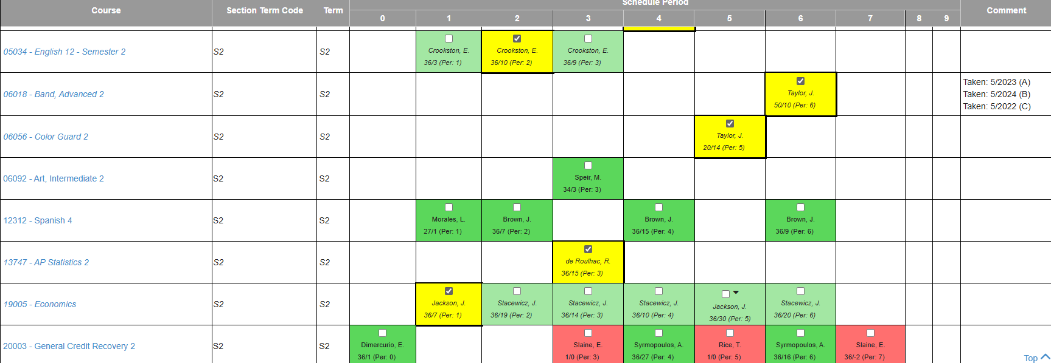
WALK-IN SCHEDULE: IT'S NOT THAT SIMPLE

Slide 16

WHAT HAPPENS AFTER THE 10 DAYS?
There is a reason why there is a 10-day deadline for changes to a student schedule.
We cannot simply add you to a class when you have missed the content (lessons, assignments, quizzes, tests, etc.), without it effecting the grading process, because you have changed your mind about a class.
We must watch the "levels" in a class. There can't be too many students in one class and too few in another class.
Your schedule is a year-long commitment.
We use the Plan for Success process to support you in classes that you are struggling in.

Slide 17
SOCIAL-EMOTIONAL SUPPORT
INDIVIDUAL CHECK-INS / COUNSELING SESSIONS
GROUP SESSIONS
CLASSROOM LESSONS
REFERRALS TO COMMUNITY RESOURCES

Slide 18

WISE MIND
A Stress Reduction Technique

Slide 19
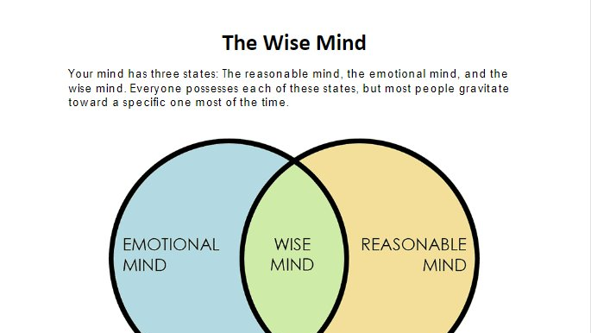

Slide 20

REASONABLE
MIND
LOGICAL
ANALYTICAL
FACTS-BASED
COOL MINDED
WHEN EXTREME:
  UNCARING
  DETACHED
  INSENSITIVE

Slide 21

EMOTIONAL
MIND
FEELINGS RULE BEHAVIOR AND THOUGHTS
SENSITIVE
ARTISTIC
WHEN EXTREME:
  OUT OF CONTROL EMOTION AND BEHAVIOR
  OVER REACTION
  FEELINGS AS FACTS

Slide 22

WISE
MIND
BALANCE BETWEEN THE EMOTIONAL AND THE REASONALBLE MINDS
RECOGNIZE AND RESPECT FEELINGS, WHILE SEEKING THE FACTS ABOUT A SITUATION
RESPONDING INSTEAD OF OVER REACTING

Slide 23

LET'S LEARN MORE...

Slide 24

WISE MIND A.C.C.E.P.T.S
ACTIVITIES-participate in an activity that creates a neutral/opposite feeling (working out, gardening, watch a show)
CONTRIBUTE-do something helpful/thoughtful for someone else (volunteer, random acts of kindness)
COMPARE-compare my reaction to how others reacted to the same situation or how you've reacted in the past
EMOTIONS-engage in activities that bring about an opposite emotion (watch funny videos)
PUSH AWAY -take a short break from emotions (imagine putting emotions in a box for a while and then return to them with a different perspective)
THOUGHTS-distract your thoughts with other busy thoughts (complete a crossword puzzle, play a strategy game)
SENSATIONS-use the 5 senses to distract from your feelings for a short break (chew crushed ice, drink hot coffee, take a hot shower or cold plunge, listen to calming noise/music, wrap yourself up in a soft blanket, light a lavender scented candle)

Slide 25

THE S.T.O.P. SKILL
Stop-freeze, stop what you are doing, don't act immediately on your feelings
Take a step back-take a short break from your emotion for a minute to help regulate your emotions
Observe-gather facts about the situation, look around and notice your surroundings
Proceed-"mindfully go", move forward to solve the problem or respond (not react) to the situation

Slide 26

HEALTHY WAYS TO MANAGE EMOTIONS

Slide 27

YOUR TURN...
WITH A NEIGHBOR OR SMALL GROUP SHARE AND DISCUSS...
A situation that may cause an impulsive reaction at school.
What are thoughts & feelings of the situation?
What would be an overreaction to the situation and what might be a consequence?
What could be a better response to the situation and how would it be better received by others?
What is the end goal of the situation?

Slide 28

WHICH "MIND" DO YOU FEED?

Slide 29

QUESTIONS?

Slide 30

Welcome Back!

