Slide 1

Counselor Lesson
QUARTER 2- 2025

Slide 2

COUNSELOR TEAM
RENEE IBARRA-Dept. Chair-Counselor (0-Z)
KRISTINE MATEOS-Counselor (A-G)
PHOTINI DESHAIES-Counselor (H-N)
DR. ALEXANDER KARAMAN-College & Career Counselor
STEVE MARKS-MTSS Facilitator

Slide 3

Credit check
4 years of English
4 years of Math
3 years of Science
1 year of World History
1 year of American History
.5 year of American Government
.5 year of Economics
1 year of Fine Arts or Career & Technical Education
.5 year of Health
1 year of Physical Education
6.5 years of Electives*
*World Language-2 consecutive years are required for colleges and university

Slide 4

Credit recovery
BEFORE OR AFTER SCHOOL

Slide 5

1st semester credit = 1st q + 2nd q grades
WINTER FINAL EXAMS
DECEMEBER 17TH & 18TH
****Summer Credit Recovery Is Limited****

Slide 6

Academic problem-solving
Have you communicated with the teacher about your struggles with the class (email, direct message, before/after class)?
Has your parent communicated with your teacher (email/phone call/conference meeting)?
Attend conference period (whether with your teacher are a different teacher who covers the same topic)
Turn in missing assignments
Retake tests/quizzes for a better grade
Monitor your progress in Canvas

Slide 7
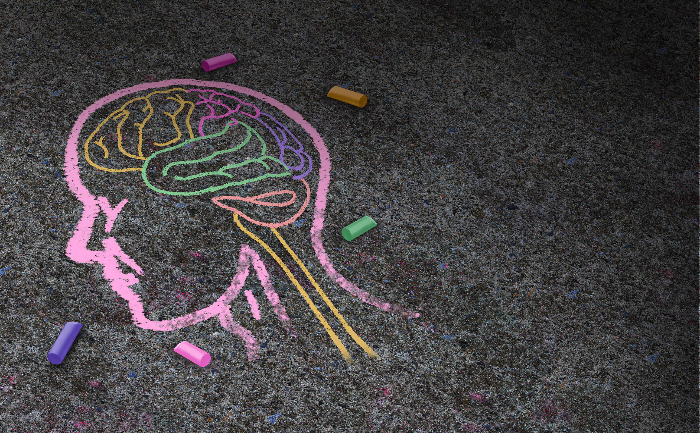
SUBSTANCE USE: AN UNHEALTHY COPING STRATEGY

Slide 8

Unhealthy actions can become unhealthy habits.
Sometimes, it's tempting to engage in activities that will give you fast stress relief. However, harmful strategies only create BIGGER problems for you down the road.

Slide 9
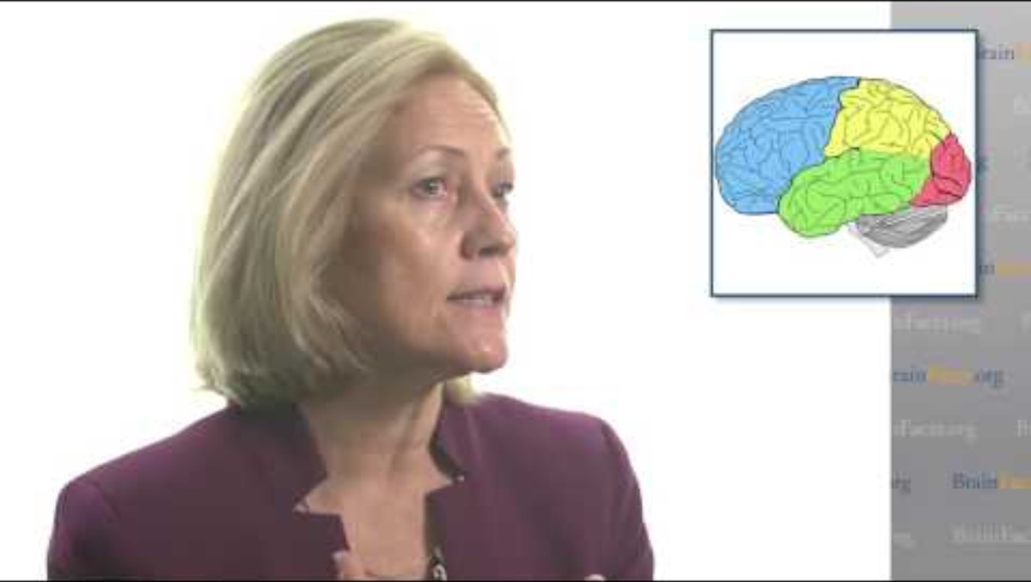
Your brain is not an adult until age 25!

Slide 10
Stages of Substance Use
No Use
Experimentation-Trying alcohol or drugs to see what it is like
Occasional or Social Use-usually use when around friends but won't go looking for substances
Regular Use-You look for substances when not available because you like the affects you get from them
Abuse-Using substances has taken up the time you used to spend on other things and has had a negative effect on your life

Slide 11

Dependency
The physical need to keep using despite the problems it causes or the desire to stop using.
You get physically ill (withdraw symptoms) when you try to quit suddenly.
You may say or think you can quit whenever you want, but you find it difficult to stop.
Your life revolves around drugs and alcohol, and you mostly focus on how to get your next high/fix.

Slide 12

Did you know?
According to research:
Teenagers move through these stages at a greater rate than adults.
It takes adults 8-10 years to move from the Experimentation Stage to the Dependency Stage
It takes a teenager anywhere from 3 to 15 months

Slide 13
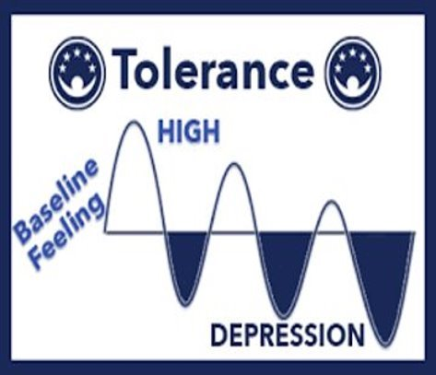
What is tolerance?
When you consume a substance so frequently, it no longer has the same effect.
Your body is getting used to the substance, so you're not getting the same high or effect as before.
This makes you take more of the substance to "chase the high" and feel the same effect as before.
As time passes, you consume more and more

Slide 14

What is addiction?
Change in behavior caused by the biochemical changes in the brain after continued substance abuse
You have no control of your mind and body.
Your brain and body feels like it needs and cannot function without the substance you are using.

Slide 15

Addiction & Your Brain

Slide 16

Signs of Addiction
Denial that substance use is harmful
Increased tolerance of the substance, so more substance is needed and more frequently for the desired effect
Damaged relationships with friends and family
Chronic relapses when trying to quit
Roller coaster emotions

Slide 17
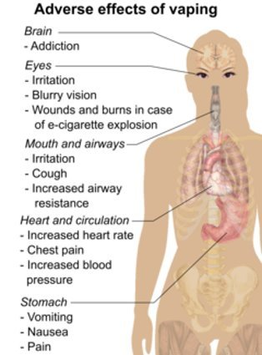
Effects of Vaping
Lead (found in car batteries) has been found in vape pens and can lead to low IQ, illness, and death
THC & nicotine levels can be much higher in vapes, without the user knowing
Some vape pens have harmful additives
Long-term effects are still unknown. Recent studies indicate lung damage (Popcorn Lung) and even some deaths
The vapor smoke contains harmful chemicals that are inhaled into the lungs and then released into the environment

Slide 18

Let's learn more...

Slide 19
What is fentanyl?
A powerful synthetic opioid, like morphine, but 50-100 times more powerful
It can lead to slowed breathing & heart rate, unconsciousness, coma, and death
In prescription form it is used to treat pain however it can be made illeagally as a street drug
"Fake Fentanyl" can be added to "Fake Pills" that look like actual prescription drugs
Life-threatening effects can occur within 2 minutes of use.

Slide 20
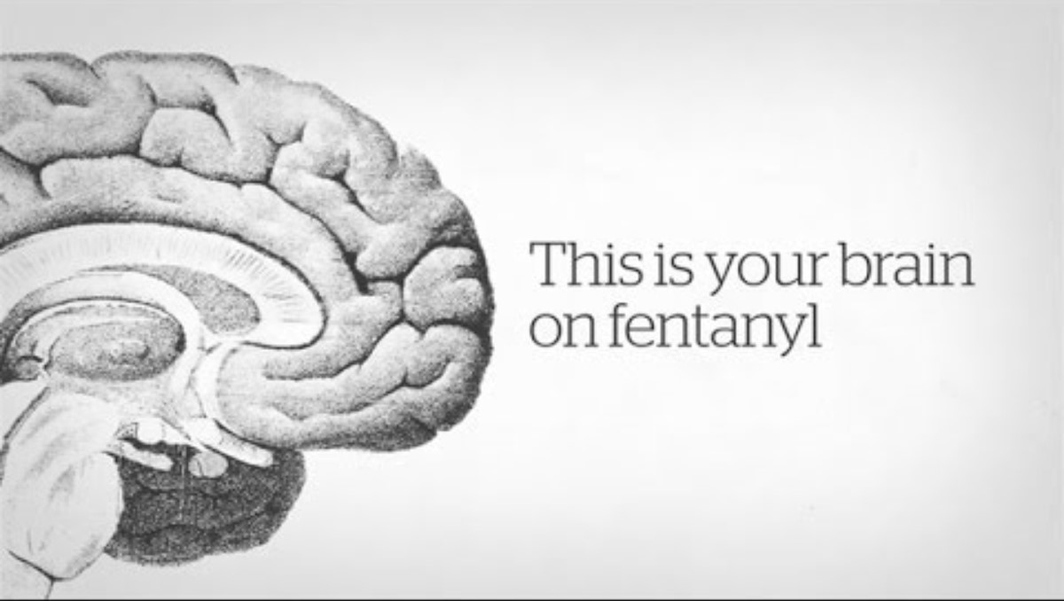
FENTANYL & THE BRAIN

Slide 21
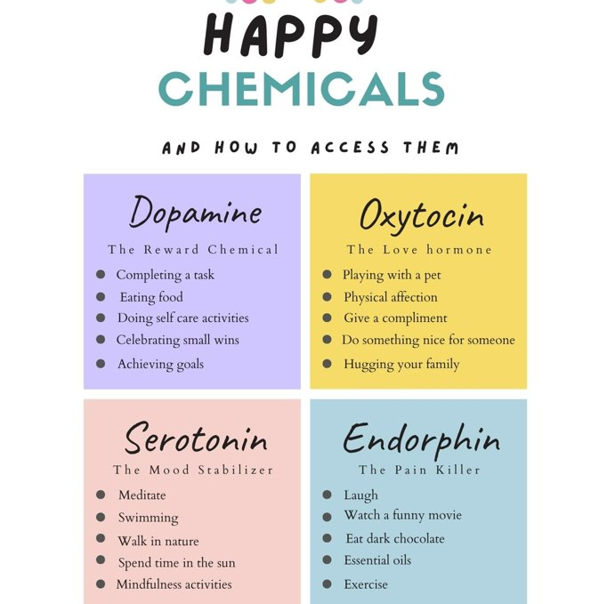
Happy brain Chemicals

Slide 22

Healthy Strategies Become Healthy Habits
Daily Activity/Exercise
Eating Healthy and Staying Hydrated
Sleep Hygiene
Time Management
Social Time
Self-Care-"Me Time"

Slide 23
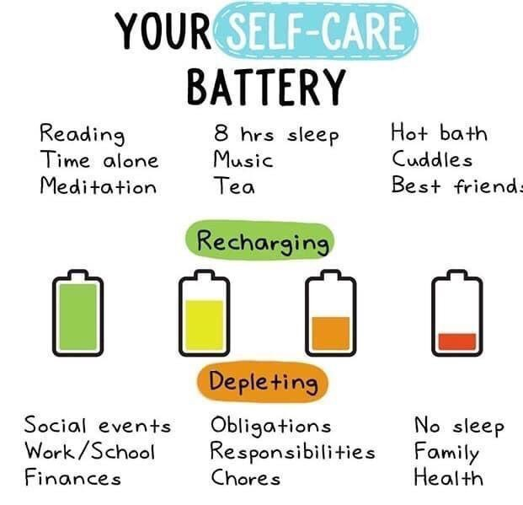
Examples of Self-Care
Exercise- hike, run, jog, go for a walk
Soothing for the mind and body- yoga, meditation, plenty of sleep, eat healthy, facials, warm baths, pedicure, manicure
Creative Expression- draw, paint, sing, dance, play music, journaling, poetry
Meet/communicate with friends or family- sometimes a good vent session helps.
Take a break from technology and/or social media
Notes:
Group connections are so important for fostering resilience and releasing chemicals in the brain that support well-being. And the activities don’t have to be just talking. Things like doing art projects together or gaming all work.

Slide 24

Tips for Prevention
Don’t be afraid to say no
Connect with your friends and avoid negative peer pressure
Make connections with your parents or other adults
Enjoy life through healthy hobbies/activities
Get educated about negative effects of alcohol and drugs
Be a role model and set a positive example
Plan ahead
Reach out for help
Notes:
Refer to Handout-
Don’t Be Afraid to Say No: Sometimes the fear of a negative reaction from peers keeps us from doing what we know is right. Don’t let someone else make the decisions for you. You have the right to say no, the right to not need a reason and the right to walk away.
Connect With Your Friends and Avoid Negative Peer Pressure: Pay attention to who you hangout with. You don’t have to go along to get along. If you are hanging with a group that gets high or drinks most of the time, maybe think about making new friends.
Make connections with your parents or other adults: As you grow up, having people you can rely on, people to talk to about life, life’s challenges and your decisions about drugs and alcohol is very important. The opportunity to benefit from someone else’s life experiences can help put things on perspective and can be invaluable.
Enjoy life and do what you love: Learn to enjoy life and people in it without adding alcohol or drugs. Substances can change who you are, limit your potential and complicate your life. “I’m bored” is just an excuse. Get out and get active in school and community activities, such as music, sports, arts or a part-time job. Giving back as a volunteer is a great way to gain perspective on life.
Follow the family rules about alcohol and drugs: As you grow up and want to assume more control over your life, having the trust and respect of your parents is very important. Don’t let alcohol and drugs come between you and your family. Talking with family about alcohol and drugs can be very helpful.
Get educated about alcohol and drugs: You cannot rely on myths and misconceptions that are out there among your friends and on the internet.
Be a role model and set a positive example: Don’t forget, what you do is more important than what you say! You are setting the foundation and direction for your life; where are you headed?
Plan ahead: As you make plans for the party or going out with friends you need to plan ahead. You need to protect yourself and be smart. Don’t become a victim of someone else’s alcohol or drug use. Make sure that there is someone you can call, day or night, no matter what, if you need them… and do the same for your friends.
Speak out/Speak up/Take control: Take responsibility for your life, your health and your safety. Speak up about what drugs and alcohol are doing to your friends, your community and encourage others to do the same.
Get help!: If you or someone you know is in trouble with alcohol or drugs, get help. Don’t wait. You don’t have to be alone.

Slide 25

When things get tough, it's okay to ask for help.
Your school counselor can help refer you to community resources
Taking care of your mental health is just as important as taking care of your physical health.

Slide 26

Remember, there are many healthy coping skills.
Healthy coping skills impact your ability to perform your best.
Find the time to slow down and take care of yourself.
Managing your stress well can help you feel better physically and mentally.
Developing healthy coping strategies early can help with a lifetime of healthy living.

Slide 27

Healthy Vs. Unhealthy Choices
Which pathway will you choose to get to your destination?

Slide 28
What's some take aways?
What makes fentanyl dangerous?
Why do teens become easily addicted compared with adults?
What is Popcorn Lung?
What makes the teen brain different compared to the adult brain?
What are natural brain chemicals?
What is sleep hygiene?
What are protective factors and what are risk factors?
What is tolerance?
What are examples of Self-Care?
What are some prevention tips?

Slide 29

QUESTIONS?

