Slide 1




Starting Your FAFSA
Notes:
Alyssa+hayleigh

Slide 2


FREE MONEY!!
  Free Application for Federal Student Aid
  Application opens December 31st, 2023
What is FAFSA?
Notes:
Alyssa- So what is the FAFSA, fafsa stands for free application for federal student aid. You will fill out this form each year you attend college to apply for financial aid that will go towards funding your education. There are two types of financial aid fafsa offers: the pell grant and unsubsidized/subsidized loans. The pell grant does not have to be paid back, while the loans do. Depending on your income eligibility, you may be able to receive up to about $7,000 a year in the pell grant. If you don’t qualify for any money from the pell grant, you still have the option to take out their loans, which will have to be paid back. The application will be open on December 31st.

Slide 3
What do you need for the FAFSA?
You need a FSA ID!!
To create your FSA ID you will need the following:
  Social Security Number
  Email
  Phone Number
  Basic Personal Information
Notes:
Hayleigh- What do you need to complete the fafsa? First things first you will need an fsa id, the fsa id will be what you use to access your application at any point in time. To create your fsa id, you will need your social security number, email address, phone number, and basic personal information such as your name, date of birth, address, etc.

Slide 4


Creating Your FSA ID
Notes:
Hayleigh

Slide 5
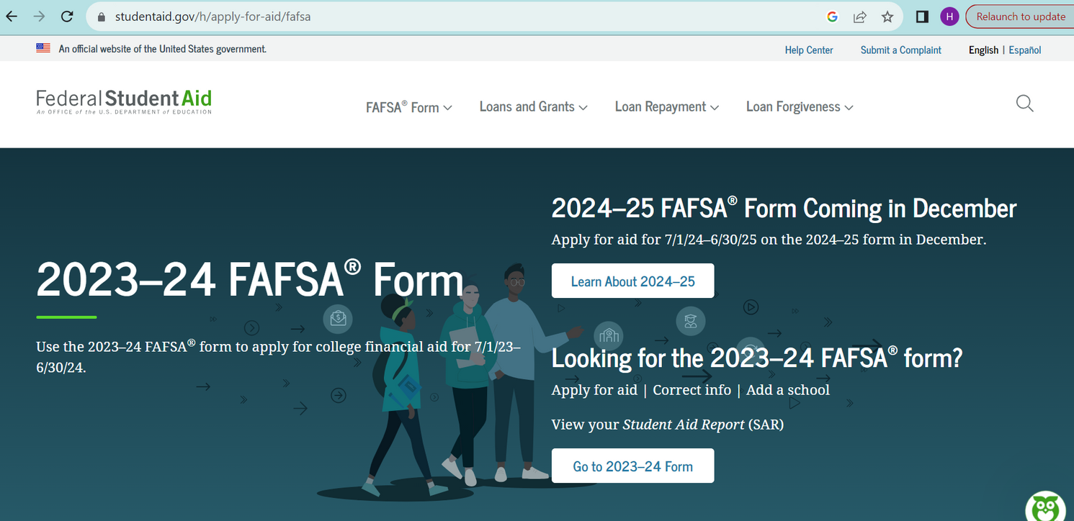

GO to FAFSA.GOV
Home Screen
Once you are here click on Learn About 2024-25
Notes:
Alyssa- So let’s get started, go ahead and type fafsa.gov into your search bar to take you where you need to be. Once you are there it should take you to the homescreen that looks just like this, go ahead and click on learn about 2024-25

Slide 6
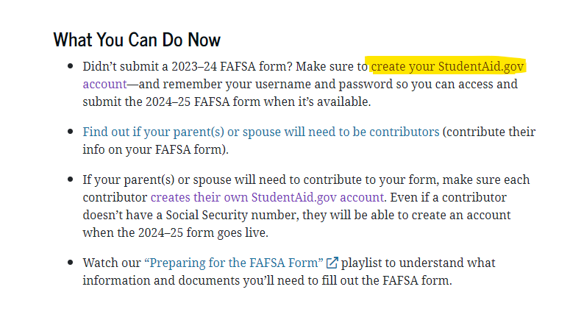

Scroll down to “What You Can Do Now”
Once you scroll down to the “What You Can Do Now” section, click on the link to “create your StudentAid.gov account”
Notes:
Hayleigh- Once you are on the page, scroll down till you see the “what you can do now” header. Underneath that section, click on create your studentaid.gov account.

Slide 7
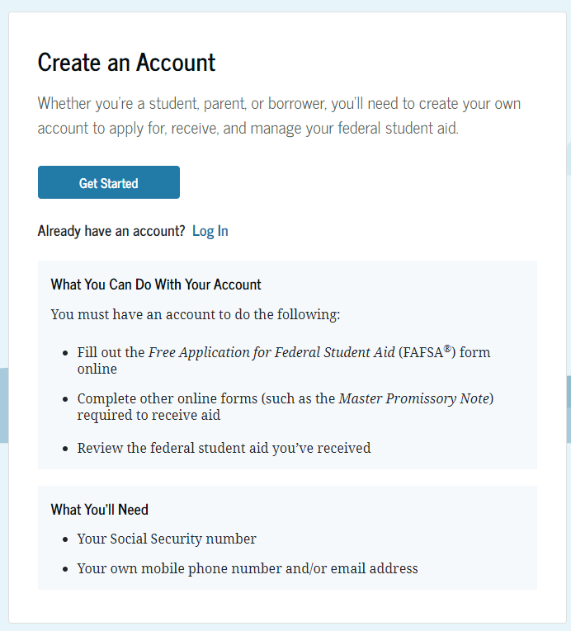
Now You Are Ready To Get Started...
The link will take you to this page to create an account.
Click “Get Started”
Notes:
Alyssa- Now you’re ready to get started on your fsa id. The page you are on should have a header that states “create account”, click on the get started button. Be sure to have your social security number, phone number, and email address handy as you get started on creating your account.

Slide 8

There are 7 total steps within creating your FSA ID
Fill out each box!!
Notes:
Hayleigh

Slide 9
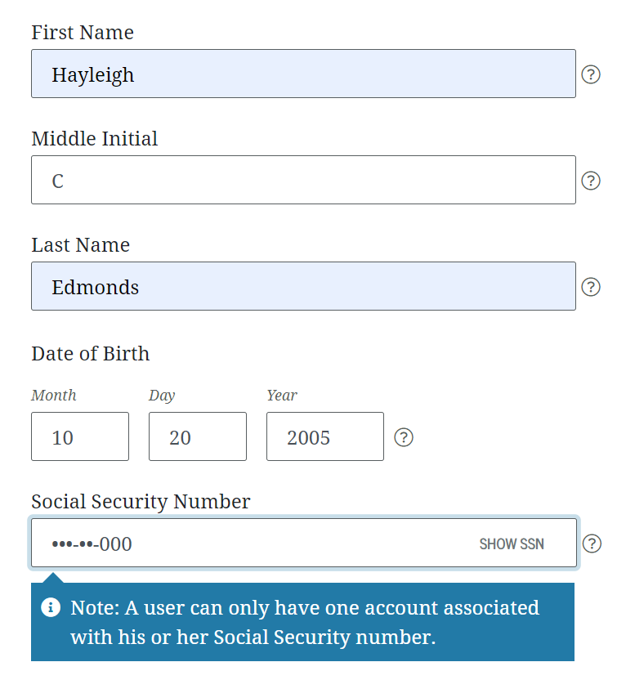

Step 1: Personal Information
First Name
Middle Initial
Last Name
Date of Birth
Social Security Number
Notes:
Hayleigh

Slide 10
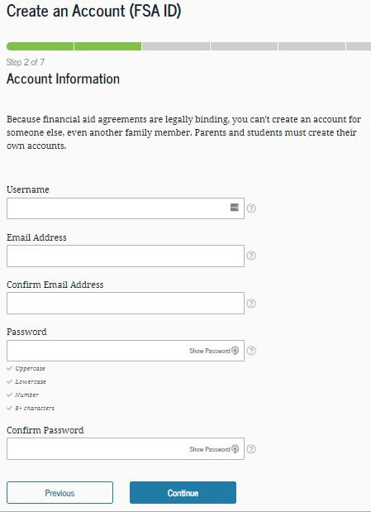
Step 2: Account Information
You will need to put in the following:
Username (DO NOT FORGET THIS!)
Email Address
Confirmation of email
Password (DO NOT FORGET THIS!)
Confirmation of password
Notes:
Alyssa- This next page is asking for your account information. First thing you will need to do, is create a username, make sure you don’t forget this!! Write down your username or keep it somewhere safe where it is easy for you to access. Make sure that your username is appropriate and professional. Next thing you will need is your email address. Remember which email address you enter because this will be the email linked to your account and be used for any username or password resets. And the last thing you will need to do on this page is create a password, again don’t forget this either, keep it someplace safe. Once you have finished entering in all of your account information, go ahead and press continue to get started on the next page.

Slide 11
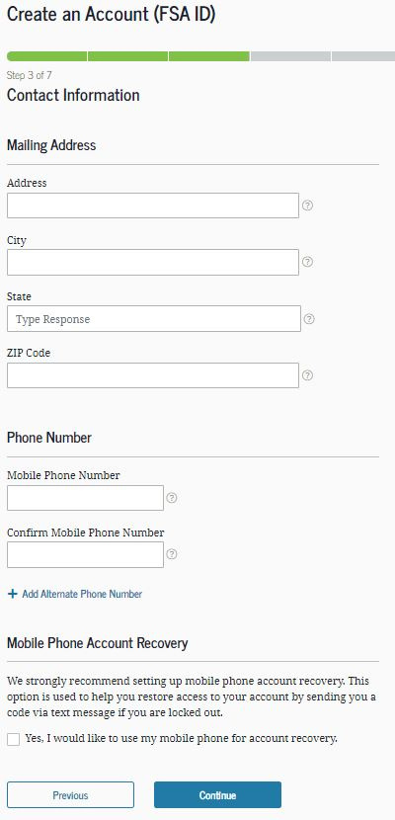
Step 3: Contact Information
You will need to provide:
Address
City
State
Zip Code
Phone number
CLICK THE YES BOX AT THE BOTTOM BEFORE CONTINUING TO THE NEXT SLIDE
Notes:
Hayleigh

Slide 12
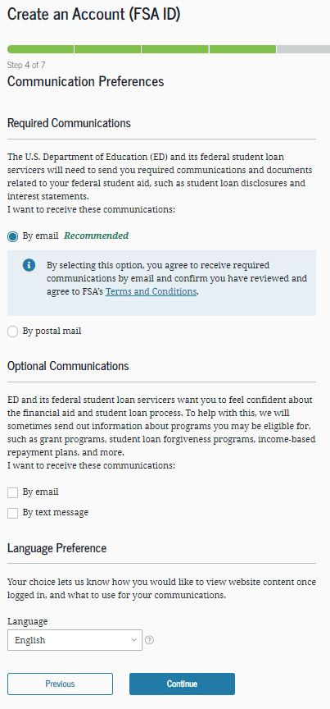
Step 4: Communication Preferences
Fill out your preferred communication styles (either by email, postal or by text messages)
Also Fill out your preferred language
Notes:
Alyssa- Now let’s get started on step 4, this page will be asking you for your communication preferences. Pick your preferred mode of communication either through email or postal mail. This will be how they will communicate to you regarding your application and financial aid. You also have the option to opt in for text messages as well. Last thing on this page will be asking you for language preference, go ahead and select which language you prefer. Once you are don’t click continue.

Slide 13

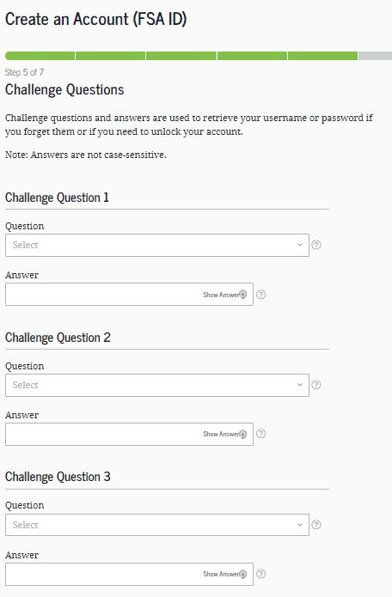
Step 5: Choose Your Challenge Questions
You will use these challenge questions to recover your account if you forget your username or password. REMEMBER YOUR CHALLENGE QUESTION ANSWERS!!
Notes:
Hayleigh

Slide 14

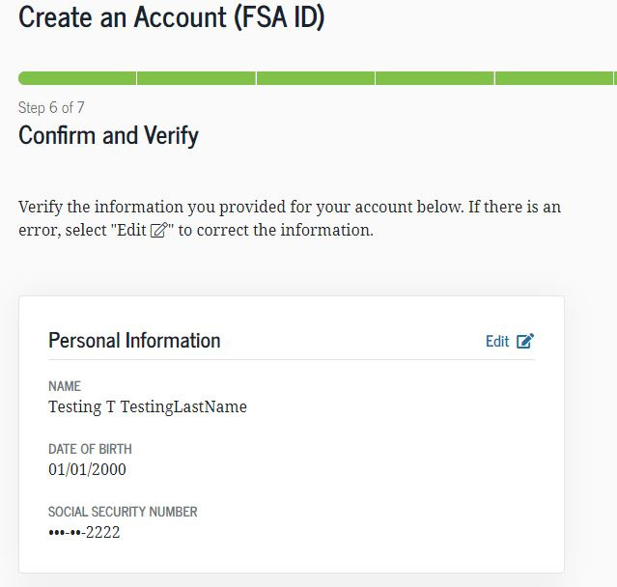
Step 6: Confirm and Verify
Review your information to confirm that everything is correct.
Click to edit any changes if needed.
Notes:
Alyssa- Step 6 will be asking you to confirm and verify your information. Scroll down and take a look at everything that you entered, make sure everything is correct. If you find any typos, click on the edit button to go in and fix it. When all your information is correct, go ahead a click verify and continue to the final step of creating your fsa id.

Slide 15
Step 7: Verify Your Contact Information
Review the contact information that you entered and confirm everything is correct
Click to edit any changes if needed
Notes:
Hayleigh

Slide 16
Processing Your FSA ID Can Take Up To 72 Hours
You will not be able to submit the FAFSA until your FSA ID has been processed and verified. However, you can begin completing the FAFSA while your FSA ID processes.
Notes:
Hayleigh

Slide 17
Thank you!

