Slide 1
Sabino Counseling
FALL 2023
10th, 11th, 12th grades
This Photo by Unknown author is licensed under CC BY-SA.

Slide 2
SABINO COUNSELING DEPARTMENT
Renee Ibarra, Dept. Chair-Academic & Mental Health (L-Z) renee.Ibarra@tusd1.org
Kristine Mateos-Academic & Mental Health (A-K) kristine.mateos@tusd1.org
Photini Deshaies-Mental Health Support photini.deshaies@tusd1.org
Dr. Alex Karaman-College & Career alexander.karaman@tusd1.org
Steve Marks MTSS (Academic) steven.marks@tusd1.org
Department Contact 520-584-7743

Slide 3
COLLEGE & CAREER READINESS
Dr. Alex Karaman
Dual Enrollment Classes
JTED Program
College Applications
Scholarship Help
Connecting with our Peer Coach
FAFSA Help
ASVAB Test support/questions
Office located in the Counseling Department office

Slide 4
Testing Schedule 2023-2024
BENCHMARK TESTS
Quarter 1: September 25th-October 3rd
Quarter 2: December 7th –December 15th
Quarter 3: February 27th-March 5th
PSAT: October 24th (9th, 10^{th,} 11th grades)
ASVAB: October 24th (12th grade)
ACT: April 2nd (For Juniors)
ACT ASPIRE: April 23rd (Freshman)
AZSCI: April 16th & 17th (For Juniors)
AP Testing: May 6th-May 17th (Various Subjects)

Slide 5
GRADING PERIODS 2023-2024
1ST SEMESTER
2ND SEMESTER
YEAR-END CREDITS
QUARTER 1-Ends Oct 6th
QUARTER 2-Ends Dec 22nd
Winter Final Exams
1st Semester Credits="D" and above
QUARTER 3-Ends March 8th
QUARTER 4-Ends May 24th
Spring Final Exams
2nd Semester credits="D" and above
SEMESTER 1 CREDITS= 0.5 per class
SEMESTER 2 CREDITS= 0.5 per class
Year-End Credits=1.0 per year-long class

Slide 6
23 credits needed to graduate
4 years of English
4 years of Math
3 years of Lab Science
1 year of World History
1 year of American History
.5 year of American Government
.5 year of Economics
1 year of Fine Arts or Career & Technical Education
.5 year of Health
1 year of Physical Education
6.5 years of Electives*
*World Language-2 consecutive years are required for university & college admission

Slide 7
ACADEMIC SUPPORT
CONFERENCE PERIOD
PLAN FOR SUCCESS MEETING
MTSS Process
TUESDAYS & THURSDAYS
8:00AM-8:55AM
Teachers are available for TUTORING
A Student-Teacher meeting, with parent and support of a Counselor and Counselor Dept. Chair, to help develop a Plan for Success in a specific class the student is struggling in.
(Multitiered System Of Support)
An academic team meeting with the MTSS Coordinator, student, parents, all the student's teachers, counselor team, and administrator to develop an MTSS Plan for support.

Slide 8
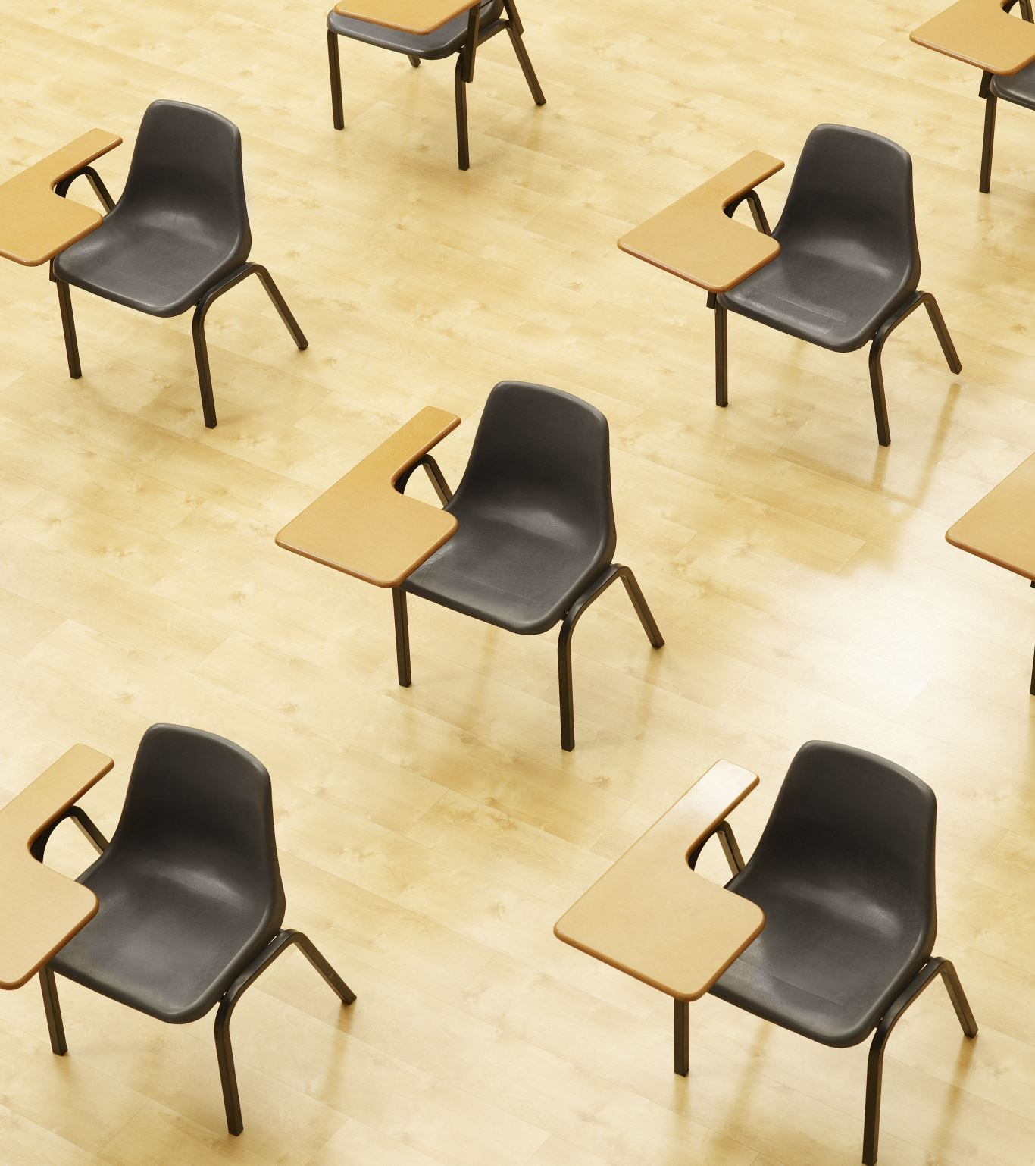
Failed Classes
If you fail a class necessary for graduation, you must make it up in Credit Recovery, options are as follows:
Online with APEX-Before school or after school option
0 period meets at 7 am on all school days
Period 7 meets 3:20-4:35 pm on all days (except Wednesdays)
Summer School-Registration opens in early May
See your Counselor to register for classes or transcript questions

Slide 9
GRADE IMPROVEMENT: New Policy *Grade improvement must be completed in a classroom, by retaking the class with a teacher. *APEX is no longer available for grade improvement.

Slide 10
MANAGING CONFLICT
PUTTING THE "I" IN "I STATEMENTS" WHILE ALLOWING YOURSELF TO BE IN SOMEONE ELSE'S SHOES.

Slide 11
PART 1: It's All About Perspective.

Slide 12
What do you see?

Slide 13
More on Perspective Taking

Slide 14
PART 2: ASSERTIVE COMMUNICATION

Slide 15
3 FORMS OF COMMUNICATION
PASSIVE
ASSERTIVE
AGGRESSIVE
Not expressing your perspective in the hope to avoid conflict or a resolution you do not like. You allow others to make decisions for you while ignoring your own personal perspectives.
Stating your perspective in a clear, direct, and meaningful way, with the goal of problem-solving. Communicating your perspective while respecting the perspective of others.
Dominating a conversation by yelling, name-calling, blaming, and only caring about your perspective.

Slide 16
"I Statements"-The foundation of assertive communication.
A good “I” statement takes responsibility for one’s own feelings or accountability for one's own role in a conflict, while calmly describing a problem or conflict.
Using "I" statements or messages allows for a respectful way to get your perspective across.
"You" statements or messages tend to blame the other person which leads them to get defensive and miss the point of your message.
Example:
You Statement (Blaming): "You can't keep coming home so late. It's so inconsiderate!"
I Statement (Accountability): "I feel worried when you come home late. I have trouble sleeping thinking you may have gotten into an accident. So maybe text me if you are running late."

Slide 17
You vs. I Statements

Slide 18
PART 3
CONFLICT RESOLUTION SKILLS

Slide 19
Conflict Resolution Skills
Assertiveness: "I" statements
Mediation: Finding common ground and a compromise
Empathy: Understanding someone else's perspective
Interviewing & Active Listening: Gather information and reflect on the information. "What I hear you say is..."
Accountability: Own your part
Creative Problem-Solving: Think outside the box and work on a mutual solution.
Facilitation: Recognize that time and place are important. This includes waiting until emotions are not so charged.

Slide 20
Reflect Feelings
Ask for More Information
Checking in
Express Understanding
Express Care
Looking for Solutions

Slide 21
Restorative Conference
Counselors and Administrators are available to help with student conflicts. If you think you need adult help with solving a conflict with someone at school, please let your counselor know.

Slide 22
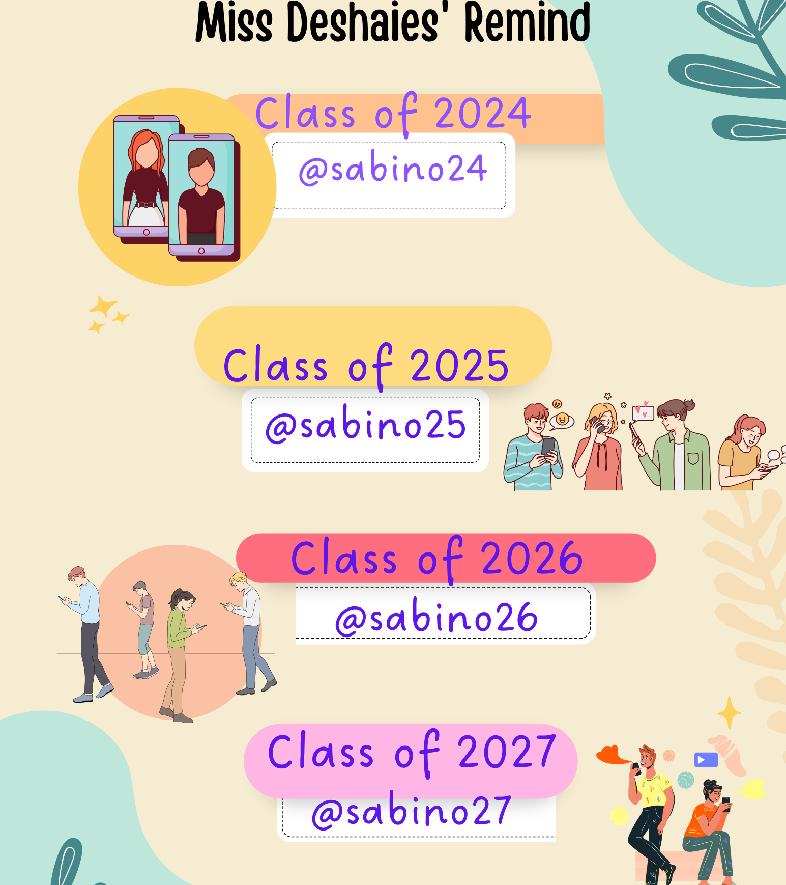
Additional Support
Daily inspirational quotes
Text Miss Deshaies directly & privately

Slide 23
Website www.tusd1.org/sabino

Slide 24
Have a great semester!
Let us know if you have questions.

