Slide 1
Sabino Counseling
FRESHMAN LESSON
FALL 2023

Slide 2
Counseling Department:
Renee Ibarra Academic & Mental Health (L-Z) renee.Ibarra@tusd1.org
Kristine Mateos Academic & Mental Health (A-K) kristine.mateos@tusd1.org
Photini Deshaies Mental Health photini.deshaies@tusd1.org
Dr. K College & Career alexander.karaman@tusd1.org
Steve Marks MTSS (Academic) steven.marks@tusd1.org
Department Contact 520-584-7743

Slide 3
Website sabinohs.tusd1.org

Slide 4
Welcome to High School

Slide 5
One Student's Sabino Journey

Slide 6
High School is a milestone and can be a big transition.
Our Counseling Department is here to offer academic & social/emotional support!

Slide 7
Counseling Department
Provide academic and social/emotional support
Academic Support
Multi Tiered Systems of Support (MTSS)
504 Plans
Course Requests
Small group and individual check-ins for Mental Health Support
Assisting students with Four Year Graduation Plan
Credit Checks for Seniors
Underclassmen upon request
Classroom Lessons for Academic and Mental Health Topics
Plan for Success Meetings
Credit Recovery Plans

Slide 9
Testing Schedule 2023-2024
BENCHMARK TESTS
Quarter 1: September 25th-October 3rd
Quarter 2: December 7th –December 15th
Quarter 3: February 27th-March 5th
PSAT: October 24th (9th, 10^{th,} 11th grades)
ASVAB: October 24th (12th grade)
ACT: April 2nd (For Juniors)
ACT ASPIRE: April 23rd (Freshman)
AZSCI: April 16th & 17th (For Juniors)
AP Testing: May 6th-May 17th (Various Subjects)

Slide 10
Changes from Middle School
Middle School
High School
Only need to pass grade levels
Failed classes are ok
Quarter grades
Need to pass all classes or risk being credit deficient
Failed classes must be made up to earn credit needed to graduate
Quarter Grades=Semester Credits

Slide 11
GRADING PERIODS 2023-2024
1ST SEMESTER
2ND SEMESTER
YEAR-END CREDITS
QUARTER 1-Ends October 6th
QUARTER 2-Ends December 22nd
Winter Final Exams
1st Semester Credits=“D” and above grades
QUARTER 3-Ends March 8th
QUARTER4-Ends May 24th
Spring Final Exams
2nd Semester Credits=“D” and above grades
SEMESTER 1 CREDITS=0.5 Per Class
SEMESTER 2 CREDITS=0.5 Per Class
YEAR-END CREDITS=1.0 Per Year-Long Class

Slide 12
Plan for 23 credits needed to graduate
4 years of English
4 years of Math
3 years of Lab Science
1 year of World History
1 year of American History
.5 year of American Government
.5 year of Economics
1 year of Fine Arts or Career & Technical Education
.5 year of Health
1 year of Physical Education
6.5 years of Electives*
*World Language-2 consecutive years are required for university & college admission

Slide 13
Freshman Courses
Core Classes
Language Arts
English 9
English 9 GATE
Math
Algebra I
Honors Algebra I
Geometry (Taken Algebra I for high school credit and received an A or B)
Honors Geometry (Taken Algebra I for high school credit and received an A or B)
Science
STEM (Taken with Algebra I)
Biology (Taken with Geometry)
OR Biotechnology (Taken with Geometry)
Health/Physical Education
Yoga (Year-long class)
Health (½-year long class)
PE (½-year long class)
Weight Training (½-year long class)
Electives
World Languages (Year-long classes)
Fine Arts (Year-long classes)
Career Technical Education (Year-long classes)

Slide 14
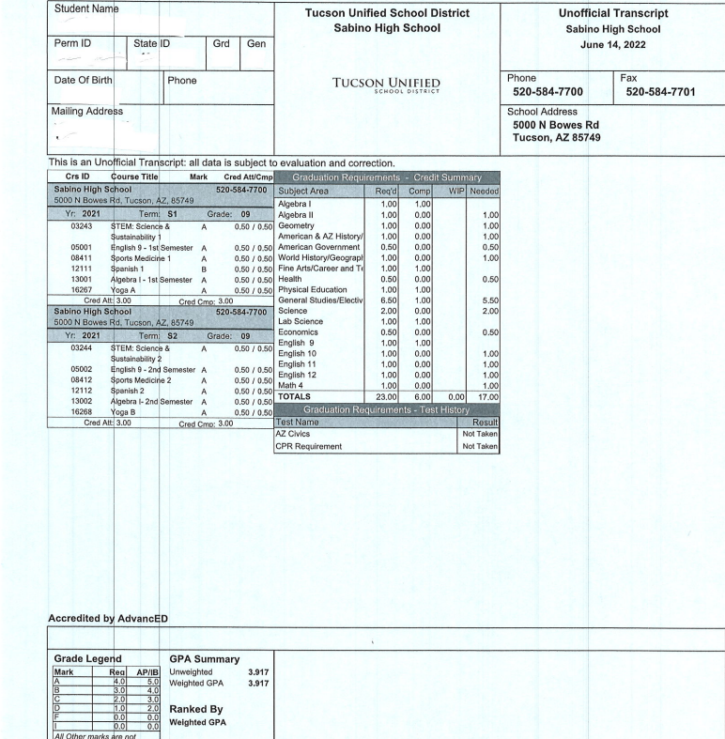
Transcript
Personal Information
Shows all credits
Beware of Repeats
Credit Summary Table

Slide 15
ACADEMIC SUPPORT
CONFERENCE PERIOD
PLAN FOR SUCCESS MEETING
MTSS Process
(Multitiered System Of Support)
An academic team meeting with the MTSS Coordinator, student, parents, all the student's teachers, counselor team, and administrator to develop an MTSS Plan for support.
TUESDAYS & THURSDAYS
8:00AM-8:55AM
Teachers are available for TUTORING
A Student-Teacher meeting, along with a parent, and support of a Counselor and Counselor Dept. Chair, to help develop a Plan for Success in a specific class the student is struggling in.

Slide 16
FAILED CLASSES: If you fail a class necessary for graduation, you must make it up in Credit Recovery. Options are:
BEFORE/AFTER SCHOOL
SUMMER SCHOOL
SCHEDULED CLASS
0-Period: Meets daily at 7am
7th Period: Meets from 3:20pm-4:35pm daily (except Wednesdays)
Registration opens in early May.
If you are missing multiple credits, a credit recovery class will be placed on your schedule. This class will replace an elective class, but without the credit.

Slide 17
Sabino Counseling Department Social/Emotional Support
Individual Check-ins
Group Sessions
Classroom Lessons

Slide 18
What Are Coping Skills?
Things you do to help you deal with the stressful things in your life
There are healthy and unhealthy ways of coping
Healthy coping skills impact your ability to perform your best
Managing your stress well can help you feel better physically and mentally

Slide 19
Tips For Stress Reduction

Slide 20
It's Okay To Ask For Help
Taking care of your mental health is just as important as taking care of your physical health.
In school: Ask to speak to the school counselor
Outside of school:
Individual Therapy
Family therapy
Group therapy (There are groups for specific needs like grief, anger management, substance abuse, family conflict, etc.)

Slide 21
Mental Health Support
Talk It Out- Free counseling services for all enrolled students and their families provided by the University of Arizona
See your counselor for more information

Slide 22
Tucson Unified Connect App

Slide 23
QUESTIONS?
Welcome! We hope you have a great year!

