Slide 1
How to Build Your First ResumÈ: Highlighting your Educational, Vocational, and Volunteer Accomplishments
Dr. Alex Karaman
College and Career Readiness Coordinator
Sabino High School

Slide 2
What Should Be in Your First Resumé
High schoolers should have a one page resumé which will grow over time with your work experience
High school takes four big years of your life, so educational experiences should be on your resumé
Your educational experiences might make up a small orl arge part of your first resumé
So, what should you put and where?

Slide 3
What Should Be in Your First Resumé
What should you include in your resumé?
Name and Contact Info
Education
Work Experience (If Applicable)
Extracurriculars
Volunteer History (If Applicable)
Skills
Not all of these will apply to everyone since not all high school students have had a job or done volunteer work
The list above is a suggestion for which topics should be included and in what order, but there is not a single format for you to stick to

Slide 4
Contact Info
Name:
Top of the Page
Slightly Larger Font
Can Be Followed with a Vertical Line
Address
Phone Number
Email (Remove Hyperlink)

Slide 5
Contact Info

Slide 6
Education
Your High School – Location
Graduation Date: Month and Year
Bullet Points Including:
GPA
Honors or AP Classes should be mentioned, but not listed individually
Academic Awards
If you confidently expect an award at graduation, list it with the date you expect to receive it

Slide 7
Education

Slide 8
Work Experience
Employer – Location
Job Title, Dates
Bulleted Points Including:
Description of Work Performed
Notable Accomplishments Or Awards At Work
All Bulleted Information Should Be Written In Past Tense Without A Subject – Do Not Use “I”
Try to have descriptions of quantity and quality (i.e. the number of patrons you serve per shift)
Indicate the type of work atmosphere (i.e. team-based, fast-paced, customer service, etc.)

Slide 9
Work Experience

Slide 10
Extracurriculars
Club/Activity – Location
Role/Title, Years
List yourself as a member separate from any leadership roles you had
Optional - Bulleted Points Including:
Description of Role Performed and Activities
Notable Accomplishments Or Awards AtIn That Activity
If you do not have much work or volunteer experience, you could expand on your extracurriculars with those bullet points.
If you do have work or volunteer experience, you might omit bullet points to save room for other, more work-related activities
Extracurriculars do not have to be at your high school and can include sports
Do not include activities you did prior to high school

Slide 11
Extracurriculars

Slide 12
Volunteer History
This should be formatted exactly as your work experience section since volunteer jobs often are similar to real jobs
Organization – Location
Job Title, Dates
Your job title here should normally be “Volunteer” unless you had a different title such as “Lead Volunteer”
Bulleted Points Including:
Description of Work Performed
All Bulleted Information Should Be Written In Past Tense Without A Subject – Do Not Use “I”
Try to have descriptions of quantity and quality (i.e. the number of patrons you serve per shift)
Indicate the type of organization it was

Slide 13
Volunteer History

Slide 14
Skills
This should be a simple bulleted list
You can use Google searches to find lists of employable skills that you can choose from if you have trouble
If you have extracurricular, work, or volunteer experience, your skills should reflect some of that history
For example, if you worked in a team-based environment, especially as a team leader, you could put “Team Building” or “Leadership” as a skill
If you used certain computer program, especially Microsoft Office programs, you might include “Computer Proficiency” or “Microsoft Office Suite” in your skills

Slide 15
Skills

Slide 16
Final Notes
Some people choose to include an “Awards and Accomplishments” section
That is fine to do, but you can also highlight those awards and accomplishments under the appropriate activity in which they happened, such as in an extracurricular activity or at work
While a high schooler’s resumé should fit on one page, if you have content for every section, it might run on to a second page but should not fill a second page
There are many ways to format a resumé and this is just one
However, do be cautious about complex resumé templates, use of color or graphics, and consistent formatting

Slide 17
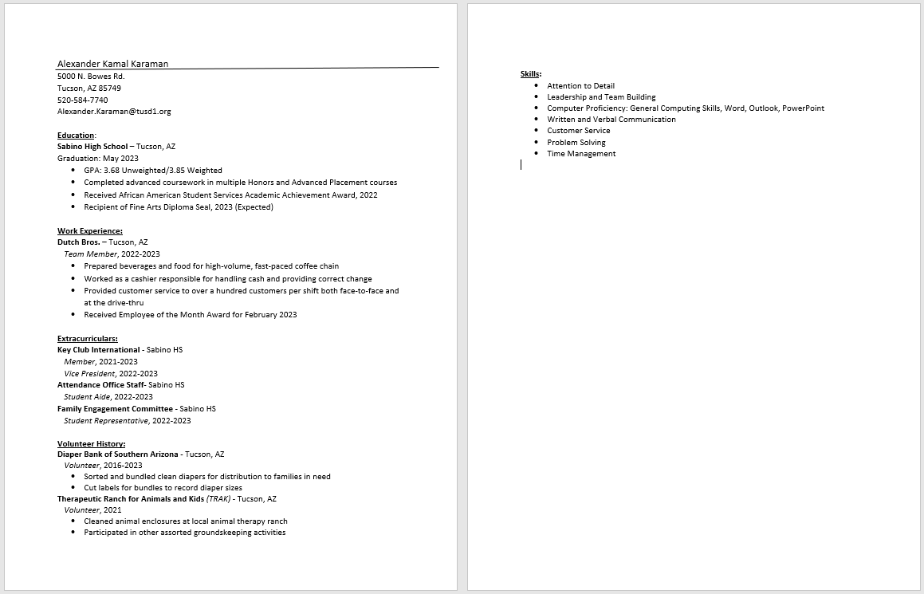
The Final Product

