Slide 1
Sabino High School
Notes:
Sabino High School is nestled in north Pima County along the Santa Catalina mountains.

Slide 2
Academics

Slide 3
Advanced Placement Classes
AP Computer Science: Principles
AP Computer Science: A
AP Statistics
AP Chemistry
AP Biology
AP Human Geography
AP World History
AP U.S. History
AP U.S. Government
AP Micro/Macro Economics
AP Calculus AB
AP Spanish Language
AP English Language (grade 11)
AP English Literature (grade 12)
AP Psychology
AP Music Theory

Slide 4
Honors Classes
Honors Algebra 1
Honors Geometry
Honors Algebra II
GATE/Honors English 9
Honors English 10
Honors English 11
Honors English 12
Honors Physics

Slide 5
Career and Technical Education
Sports Medicine
Computer Science
Biotechnology
Graphic Web Design
Digital Photography
Digital Communications (Yearbook)

Slide 6
VISUAL & PERFORMING ARTS
ART
DRAMA
ORCHESTRA
BAND
VOCAL MUSIC
GUITAR
AP MUSIC THEORY
COLOR GUARD
TECHNICAL THEATER

Slide 7
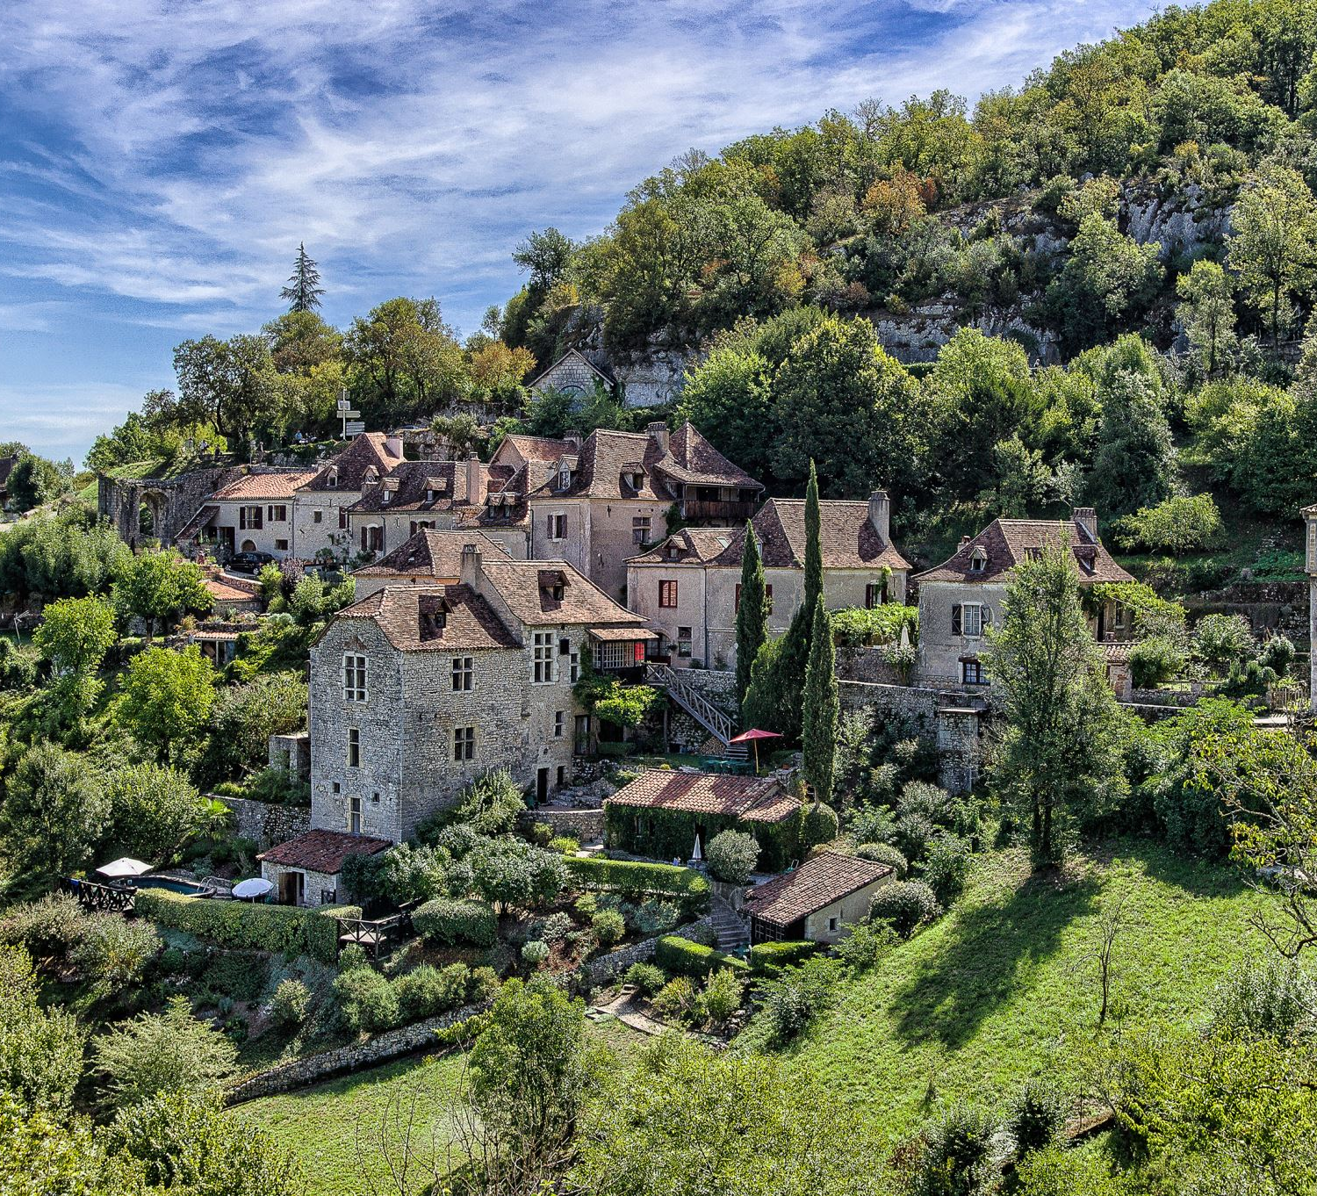
WORLD LANGAUGES
2 YEARS REQUIRED FOR UNIVERSITY/COLLEGE ACCEPTANCE

Slide 8
SABINO'S WORLD LANGUAGES
AMERICAN SIGN LANGUAGE
SPANISH
AMERCIAN SIGN LANGUAGE (YEAR 1)
AMERICAN SIGN LANGAUGE (YEAR 2)
SPANISH (YEAR 1)
SPANISH (YEAR 2)
HONORS SPANISH (YEAR 3)
HONORS SPANISH (YEAR 4)
AP SPANISH (YEAR 5)

Slide 9
PHYSICAL EDUCATION & HEALTH
HEALTH (0.5 CREDIT)
PHYSICAL EDUCAITON
WEIGHT TRAINING
YOGA
ADVANCED YOGA
BODY CONDITIONING

Slide 10
GENERAL COURSES
CRIMINAL MINDS
STUDENT GOVERNEMENT
AP PSYCHOLOGY
AP HUMAN GEOGRAPHY
FILM ANALYSIS
STUDENT AIDE
ACADEMIC CORE

Slide 11
Dual Enrollment
Math 151
English 101
English 102
HIS 141/142
WRT 101S

Slide 12
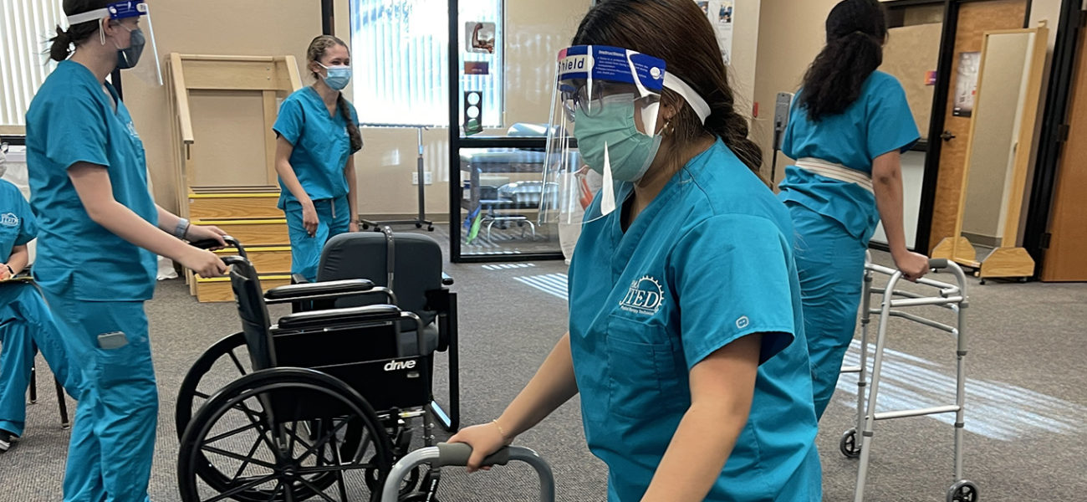
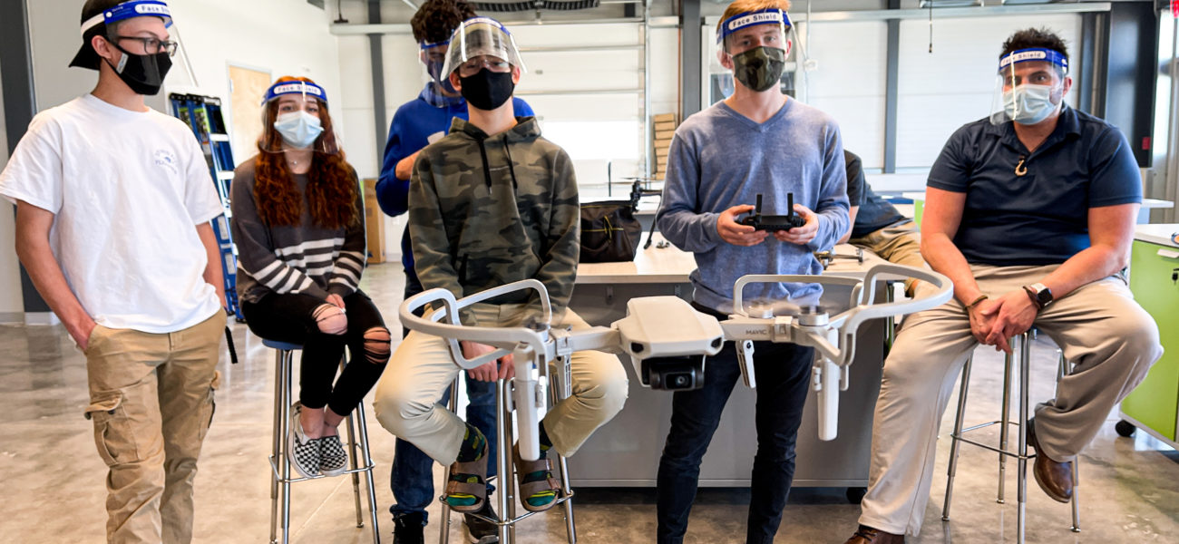

Slide 13
Pima Joint Technical Education District
Construction Technologies II
Nursing Services
Veterinary Science
Engineering Tech I B
Automotive Technology
Fire Service

Slide 14
ATHLETICS
AWARD-WINNING TEAMS

Slide 15
SPORTS TEAMS AT SABINO
BASEBALL
BASKETBALL
CROSS COUNTRY
FOOTBALL
GOLF
SOCCER
SOFTBALL
SPIRIT LINE
SWIM/DIVE
TENNIS
TRACK
VOLLEYBALL
WRESTLING

Slide 16
Clubs
National Honor Society
Band & Orchestra
Debate
Student Council
Key Club
LGBT + Union
Improv & Drama
Pomline
Yearbook
Notes:
Community Service

Slide 17
Student Supports

Slide 18
Counseling Department
Provide academic and social/emotional support
Academic Support
Multi Tiered Systems of Support (MTSS)
504 Plans
Course Requests
Small group and individual check-ins for Mental Health Support
Assisting students with Four Year Graduation Plan
Credit Checks for Seniors
Underclassmen upon request
Classroom Lessons for Academic and Mental Health Topics
Plan for Success Meetings
Credit Recovery Plans

Slide 19
Our College and Career Readiness Services
College Readiness
Career Readiness
College Fair (Fall)
College Major Matching
College Search Assistance
Admissions Process Assistance
FAFSA and Financial Aid
College Readiness Workshops
Letters of Recommendation
College and Scholarship Essay Help
Career Fair (Spring)
Resume Building Workshops
Practice Interviews
Career and Technical Education Support and Class Visits
JTED Program Counseling
Major Clarity Class Lessons

Slide 20
MIDDLE SCHOOL TO HIGH SCHOOL
A TIME OF EXCITEMENT AND CHANGE

Slide 21
Changes from Middle School
Middle School
High School
Only need to pass grade levels
Failed classes are ok
Quarter grades
Need to pass all classes or risk being credit deficient
Failed classes must be made up to earn credit needed to graduate
Quarter Grades=Semester Credits

Slide 22
GRADING PERIODS / SEMESTERS
1ST SEMESTER
2ND SEMESTER
YEAR-END CREDITS
QUARTER 1-Ends in October
QUARTER 2-Ends in December
Winter Final Exams
1st Semester Credits=“D” and above grades
QUARTER 3-Ends in March
QUARTER4-Ends in May
Spring Final Exams
2nd Semester Credits=“D” and above grades
SEMESTER 1 CREDITS=0.5 Per Class
SEMESTER 2 CREDITS=0.5 Per Class
YEAR-END CREDITS=1.0 Per Year-Long Class

Slide 23
ACADEMIC SUPPORT
CONFERENCE PERIOD
PLAN FOR SUCCESS MEETING
MTSS Process
(Multitiered System Of Support)
An academic team meeting with the MTSS Coordinator, student, parents, all the student's teachers, counselor team, and administrator to develop an MTSS Plan for support.
TUESDAYS & THURSDAYS
8:00AM-8:55AM
Teachers are available for TUTORING
A Student-Teacher meeting, along with a parent, and support of a Counselor and Counselor Dept. Chair, to help develop a Plan for Success in a specific class the student is struggling in.

Slide 24
Plan for 23 credits needed to graduate
4 years of English
4 years of Math
3 years of Lab Science
1 year of World History
1 year of American History
.5 year of American Government
.5 year of Economics
1 year of Fine Arts or Career & Technical Education
.5 year of Health
1 year of Physical Education
6.5 years of Electives*
*World Language-2 consecutive years are required for university & college admission

Slide 25
Early Graduation Potential
Graduate in 3 years instead of 4 years
Must have a GPA of 3.0
Must have Credit in Algebra I and Geometry BEFORE the start of 10th grade year

Slide 26
Freshman Courses
Core Classes
Language Arts
English 9
English 9 GATE/Honors
Math
Algebra I
Honors Algebra I
Geometry (Taken Algebra I for high school credit and received an A or B)
Honors Geometry (Taken Algebra I for high school credit and received an A or B)
Science
STEM (Taken with Algebra I)
Biology (Taken with Geometry)
Health/Physical Education
Yoga (Year-long class)
Health (½-year long class)
PE (½-year long class)
Weight Training (½-year long class)
Body Conditioning
Electives
World Languages (Year-long classes)
Fine Arts (Year-long classes)
Career Technical Education (Year-long classes)

Slide 27
REGISTRATION
Parent Vue
Contact Sabino's Registrar
Christine Behrens
520-584-7715
Christine.behrens@tusd1.org
Course Request: https://sabinohs.tusd1.org/Academics
Transcripts
For any High School Credit taken at Middle School, please provide your transcript to Sabino's registrar.

Slide 28
Summer Programs-June
AP Boot Camp
Freshman Academy/Jumpstart
Earn 0.5 elective credit
Become familiar with our campus
Meet new friends
Meet the staff/teachers

