Slide 1
SABINO COUNSELING
SPRING 2024

Slide 2
Almost there…

Slide 3
SPRING TESTING DATES
ACT: April 2nd (For Juniors)
ACT ASPIRE: April 23rd (Freshman)
AZSCI: April 16th (For Juniors)
AP Testing: May 6th-May 17th (Various Subjects)
FINAL EXAMS:
Seniors: May 20th & 21th
Everyone else: May 22nd & 23rd

Slide 4
GRADUATION: Thursday, May 23rd

Slide 5
Next Stop: Graduation!
SPRING GRADUATION: MAY
SUMMER GRADUATION: JUNE
WINTER GRADUATION: DECEMBER

Slide 6
CREDIT CHECK
4 years of English
4 years of Math
3 years of Science
1 year of World History
1 year of American History
.5 year of American Government
.5 year of Economics
1 year of Fine Arts or Career & Technical Education
.5 year of Health
1 year of Physical Education
6.5 years of Electives*
*World Language-2 consecutive years are required for university & college admission

Slide 7
SUMMER SCHOOL
CREDIT RECOVERY
FRESHMAN ACADEMY
AP BOOTCAMP
WORK AHEAD (non-core classes)

Slide 8
GRADE IMPROVEMENT: New Policy *Grade improvement must be completed in a classroom, by retaking the class with a teacher. *APEX is no longer available for grade improvement.

Slide 9
SUMMER SCHOOL: May 29th-June 26th
TWO SESSIONS
SESSION 1: 5/29-6/11
SESSION2: 6/12-6/26
8:00 am until 2:00pm
APEX PROGRAM​
self-paced, computer program​
IN-PERSON INSTRUCTION​
classroom environment with ​a teacher​
*Both options are on campus!​
**There is no online only, off campus option this year. ​

Slide 10
SEE YOUR COUNSELOR IF YOU HAVE QUESTIONS

Slide 11
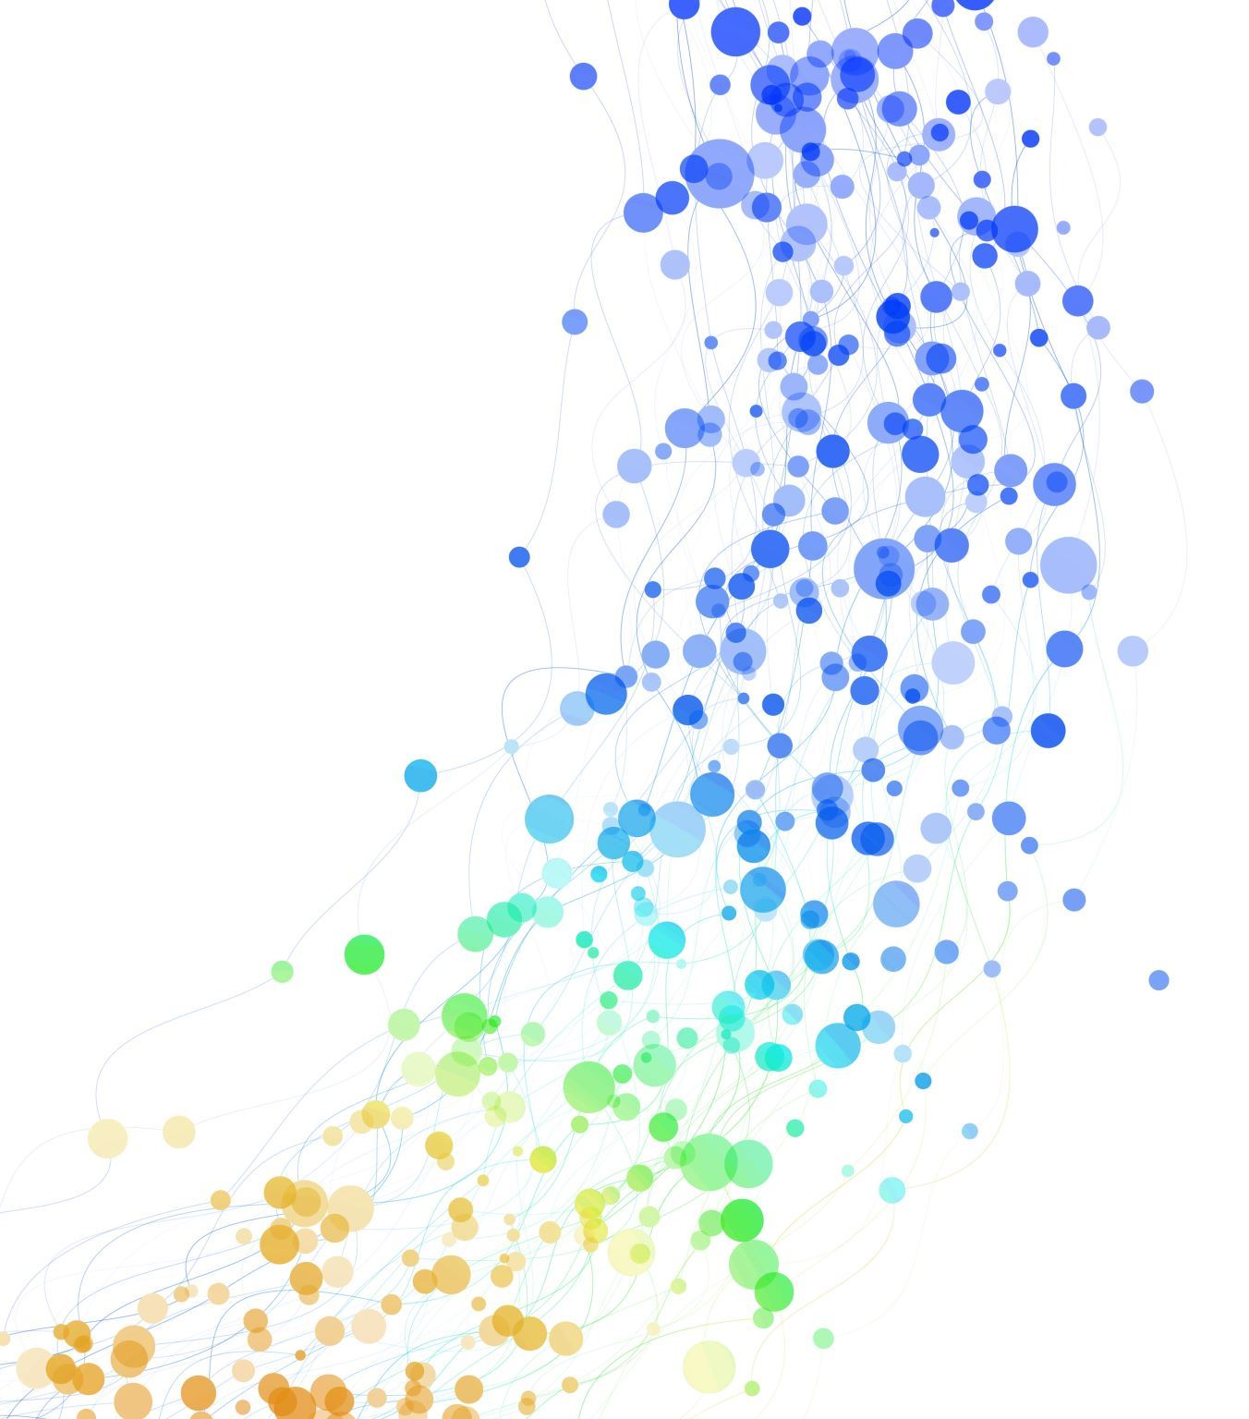
Self-Awareness

Slide 12
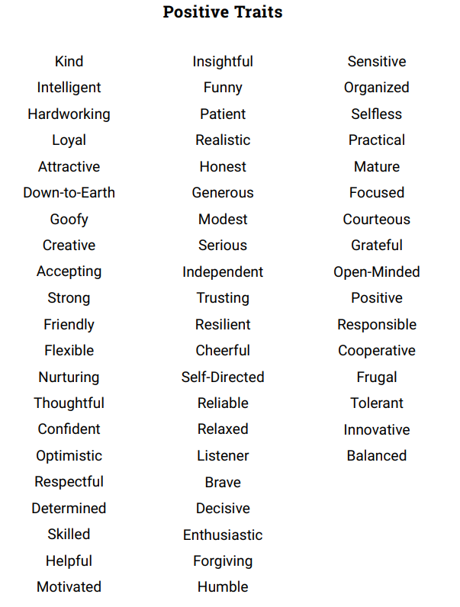
PICK 3 POSITIVE TRAITS ABOUT YOURSELF...
How do you use these traits as a personal strength?

Slide 13
Self-awareness is your ability to perceive and understand the things that make you who you are as an individual, including your personality, actions, values, beliefs, emotions, and thoughts.

Slide 14
Why is it important to be Self-Aware?

Slide 15
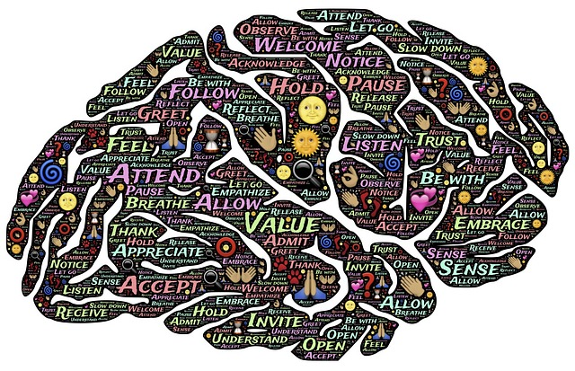

Slide 16
GET TO KNOW YOURSELF

Slide 18
Self-awareness in our environment

Slide 19
Self-awareness is the ability to focus on yourself and how your actions, thoughts, or emotions do or don't align with your internal standards. If you're highly self-aware, you can objectively evaluate yourself, manage your emotions, align your behavior with your values, and understand correctly how others perceive you.

Slide 20
SOCIAL MEDIA & SELF-ESTEEM

Slide 21
Internal Vs. External Validation Of Self
WHAT'S IN YOUR BACKPACK?
Are there things that you want in there?
Are you letting other people's junk fill your backpack?
Are you carrying around other people's stuff?
Did you fill up your own backpack with what you need?

Slide 22
Have a great summer!

